Slide 1


Impact of Science Conference the Parallel Session on:
Assessment Beyond Bibliometrics
24th June, 2021

Slide 2


Impact of Science
23-25 June, 2021
Eric Jensen : Assistant Professor in Sociology, Warwick University, United Kingdom
Alan Paic: Senior Policy Analyst at Organisation for Economic Co-operation and Development (OECD), France
Harsha Dayal: Director of Research Department of Planning, Monitoring, and Evaluation, South Africa
Overview of the Speakers
#IOS21

Slide 3
Impact of Science
23-25 June, 2021
Eric Jensen
Assistant Professor in Sociology, Warwick University, United Kingdom
#IOS21

Slide 4



@JensenWarwick
Session introduction
Why indicators matter
Research impact assessment beyond bibliometrics
Dr. Eric A. Jensen – e.jensen@warwick.ac.uk
This project has received funding from the European Union’s Horizon 2020 research and innovation programme under grant agreement No 788503.

Slide 5


@JensenWarwick

Slide 6



Current work
@JensenWarwick
e.jensen@warwick.ac.uk
Trainer/Consultant on impact evaluation
Methodsforchange.org
Senior Research Fellow,
RRING.eu
GRRIP.eu
MUSICA:
Musica-project.eu
Associate Professor (part-time)
Dept. of Sociology

Slide 7


Slide 8


Slide 9
Why indicators matter
Measuring the impact of science is important
Identifying how such measurement can be made methodologically robust, globally relevant and practically useful can be challenging
One approach that is often used in this context is indicators, that is, documented measures that can be used to track the outcomes associated with a given intervention or social movement.

Slide 10
Key challenges in assessment beyond bibliometrics
Key issue is whether the indicator accurately reflects the intended outcome.
At a conceptual level, indicators can be challenging to develop because of the diverse range of interpretations of what it means to develop positive impact, both within countries and globally.
Clear conceptual elaboration, connected to empirical measures, is the gold standard in how to proceed with development of well-designed indicators.
At a practical level, it is important to clarify who will take responsibility for implementing indicators, ensuring they have the appropriate skillset and resources to do this effectively.

Slide 11
Key challenges in assessment beyond bibliometrics
There are many cases when poor choices of indicators have done more harm than good (e.g., see Jensen and Lister, 2015).
Indicators offer just one way to evaluate progress. The passive nature of indicators, often developed separately from the intervention itself, comes with potential limitations.
On the other hand, appropriate indicators can provide a vital source of accountability when it comes to public and institutional policy. Empirical indicators are a check on untamed claims of impact and positive change.
For this reason, pursuit of appropriate evaluation methods is worthwhile, particularly when the aim is to use emerging evidence to improve policy and practice.

Slide 12
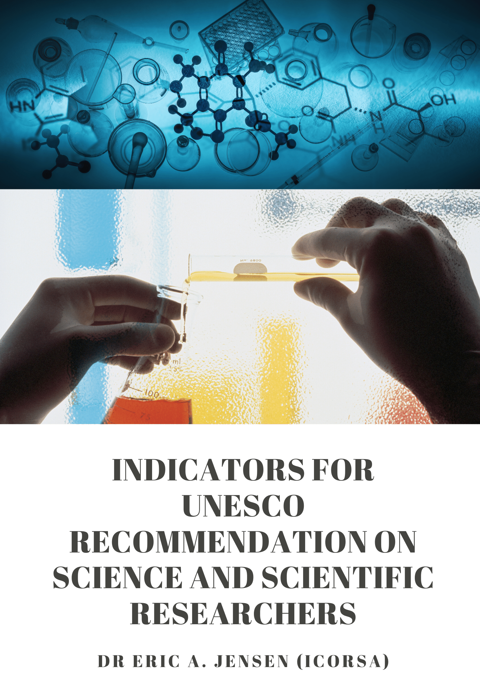


Dr. Eric A. Jensen
@JensenWarwick (Twitter)
Introducing the UNESCO Recommendation on Science & Scientific Researchers
This project has received funding from the European Union’s Horizon 2020 research and innovation programme under grant agreement No 788503.

Slide 13
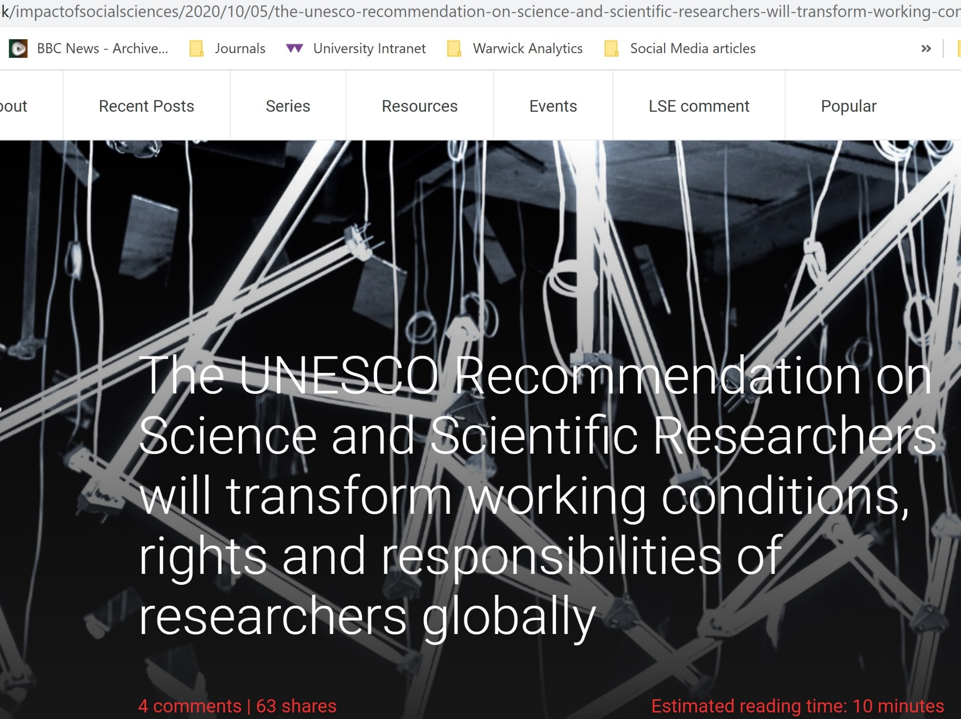


Slide 14

Ten key priority areas for global implementation and four-yearly monitoring.

Slide 15
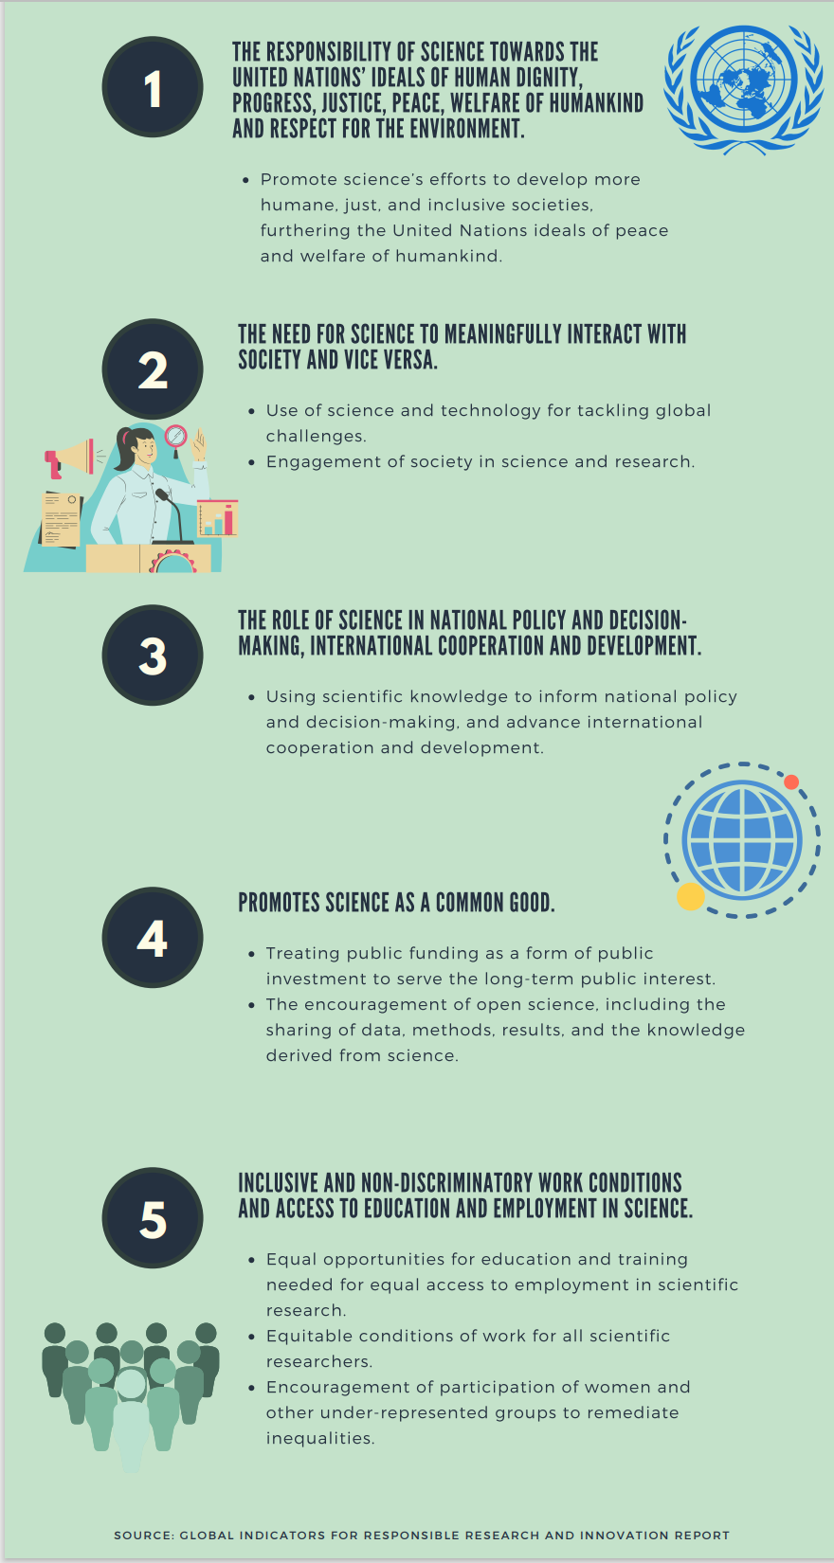
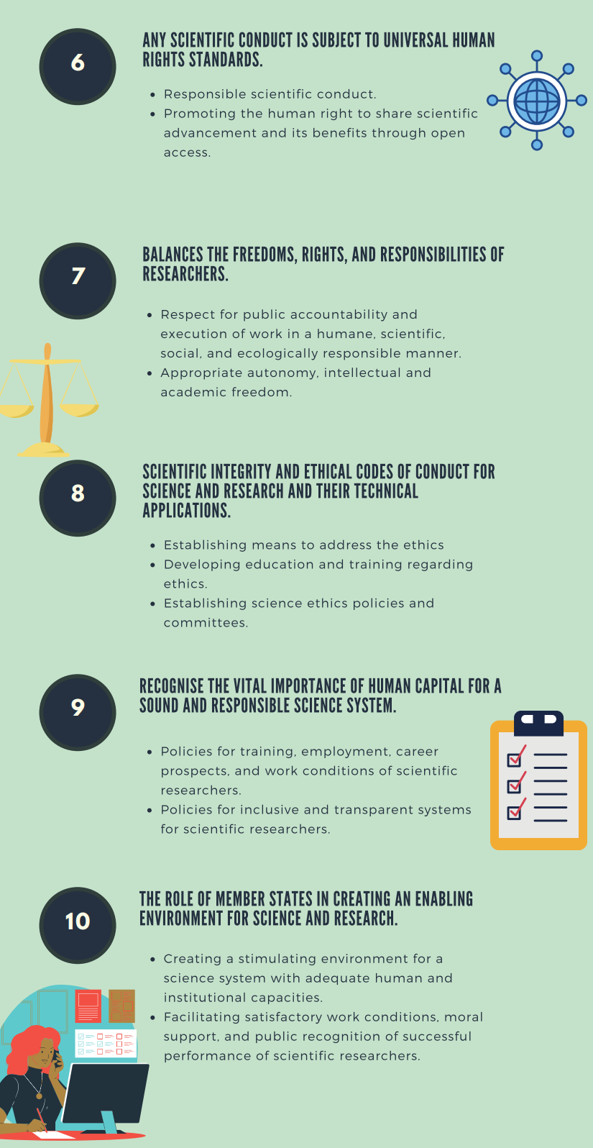
Priority areas for 4-yearly monitoring process

Slide 17
Levels of measurement
RRING: Developing measures that can be employed at different levels in member state scientific systems to evaluate progress towards full implementation of the RSSR.
By applying indicators across these levels, we can track progress as RSSR implementation cascades from national policy through to research funding systems, research performing organisations and finally to individual researchers.

Slide 18
Levels of measurement: Member State
1. Member State (National Reporting)
Traditional focus for UN statistics in general and UNESCO indicators in particular.
Representatives for the Member State report objective statistics about the status of a number of variables to give a high level picture.
Notes:
Note: the indicators proposed for this level in this document can be replicated at regional government level, where appropriate (e.g. where responsibility for science and science funding have been devolved to regional level), to provide a more fine-grained picture.

Slide 19
Levels of measurement: RFOs
2. Research Funding Organisations (RFOs)
A key way Member States can implement the RSSR is through research funding allocations and policies.
Prioritisation of mission-oriented funding, strings attached and selection criteria in competitive application processes can help align a Member State’s research system with RSSR principles.

Slide 20
Levels of measurement: RPOs
3. Research Performing Organizations (RPOs)
The institutions employing research staff are central in the research system, affecting how researchers are treated, supported and maintained in sustainable careers.
While RPOs often take cues from governments and research funders, they have their own norms, policies and practices.
This means that such organisations are important to evaluate directly to understand progress at this crucial institutional level.

Slide 21
Levels of measurement: Researchers
4. Research Staff
Individual research staff are a key player in the RSSR, whose voice should be included in assessments of progress in RSSR implementation.
We provide indicators to provide the ‘bottom up’ vantage point of individual researchers.

Slide 22
Levels of measurement: Public
5. General public
A number of RSSR principles have implications for public views on the role of science.
Indicator dimension focusing on the public aspect of the RSSR priority areas can be aligned to existing measures such as The Wellcome Trust Global Monitor.

Slide 23
Overall approach
The five levels of indicators developed through RRING can be used in concert to provide a well-rounded picture of progress in the implementation of the RSSR:
  Including ‘top down’ (government and funders) and ‘bottom up’ (research staff, research performing organisations and general public) levels.

Slide 24
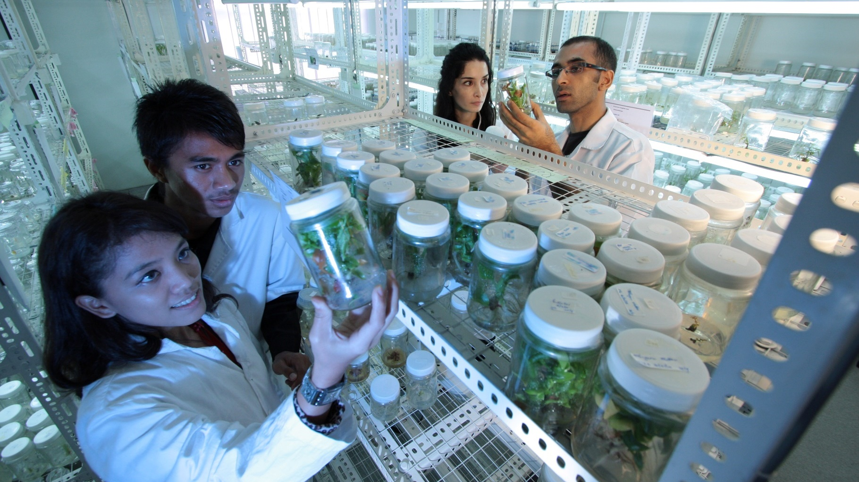
Indicator Framework for 10 Priority Areas of the UNESCO Recommendation on Science and Scientific Researchers

Slide 25
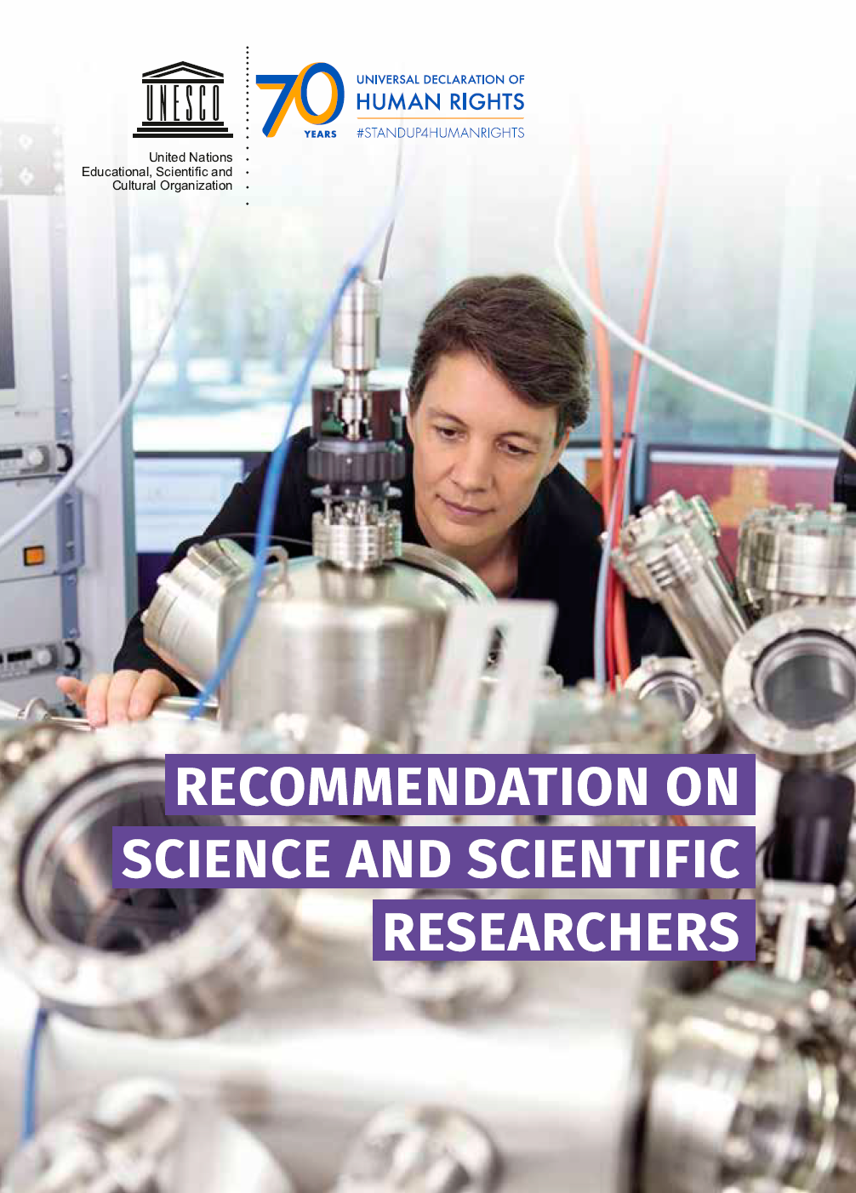
UNESCO Recommendation on Science & Scientific Researchers
@JensenWarwick
TOOLS FOR UNESCO MEMBER STATES TO GATHER INFORMATION ON POLICY MEASURES AND INDICATORS FOR THE RECOMMENDATION ON SCIENCE AND SCIENTIFIC RESEARCHERS
This project has received funding from the European Union’s Horizon 2020 research and innovation programme under grant agreement No 788503.

Slide 26
UNESCO Recommendation on Science and Scientific Researchers:
Gathering information
CHALLENGE - Need for information about measures to address the 10 Key Priority Areas and indicators/evidence to underpin reported outcomes.
OPPORTUNITY - Save resources and enhance quality by deploying tailored digital surveys with subject matter experts in each country.

Slide 27
UNESCO Recommendation on Science and Scientific Researchers:
Gathering information
SURVEYING EXPERTS:
Digital surveys made available for gathering Member State level information about measures and indicators
Mapped against 10 Key Priority Areas

Slide 28
EXAMPLE – Gathering relevant information on measures and indicators for Key Priority Area 2
2. STI and Society
Knowledge Society
Peaceful Applications of S&T
Scientific Culture

Slide 29
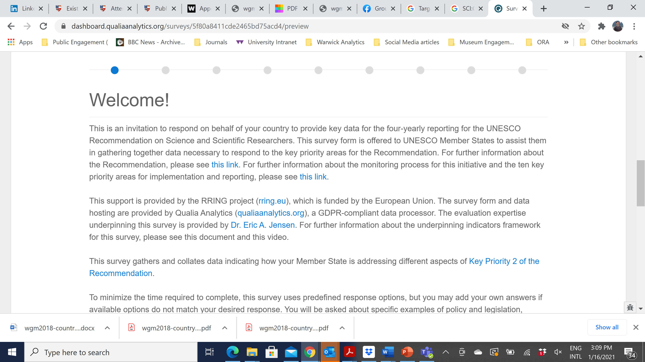

Surveys designed for subject matter experts on science, research and innovation policy within the Member State

Slide 30
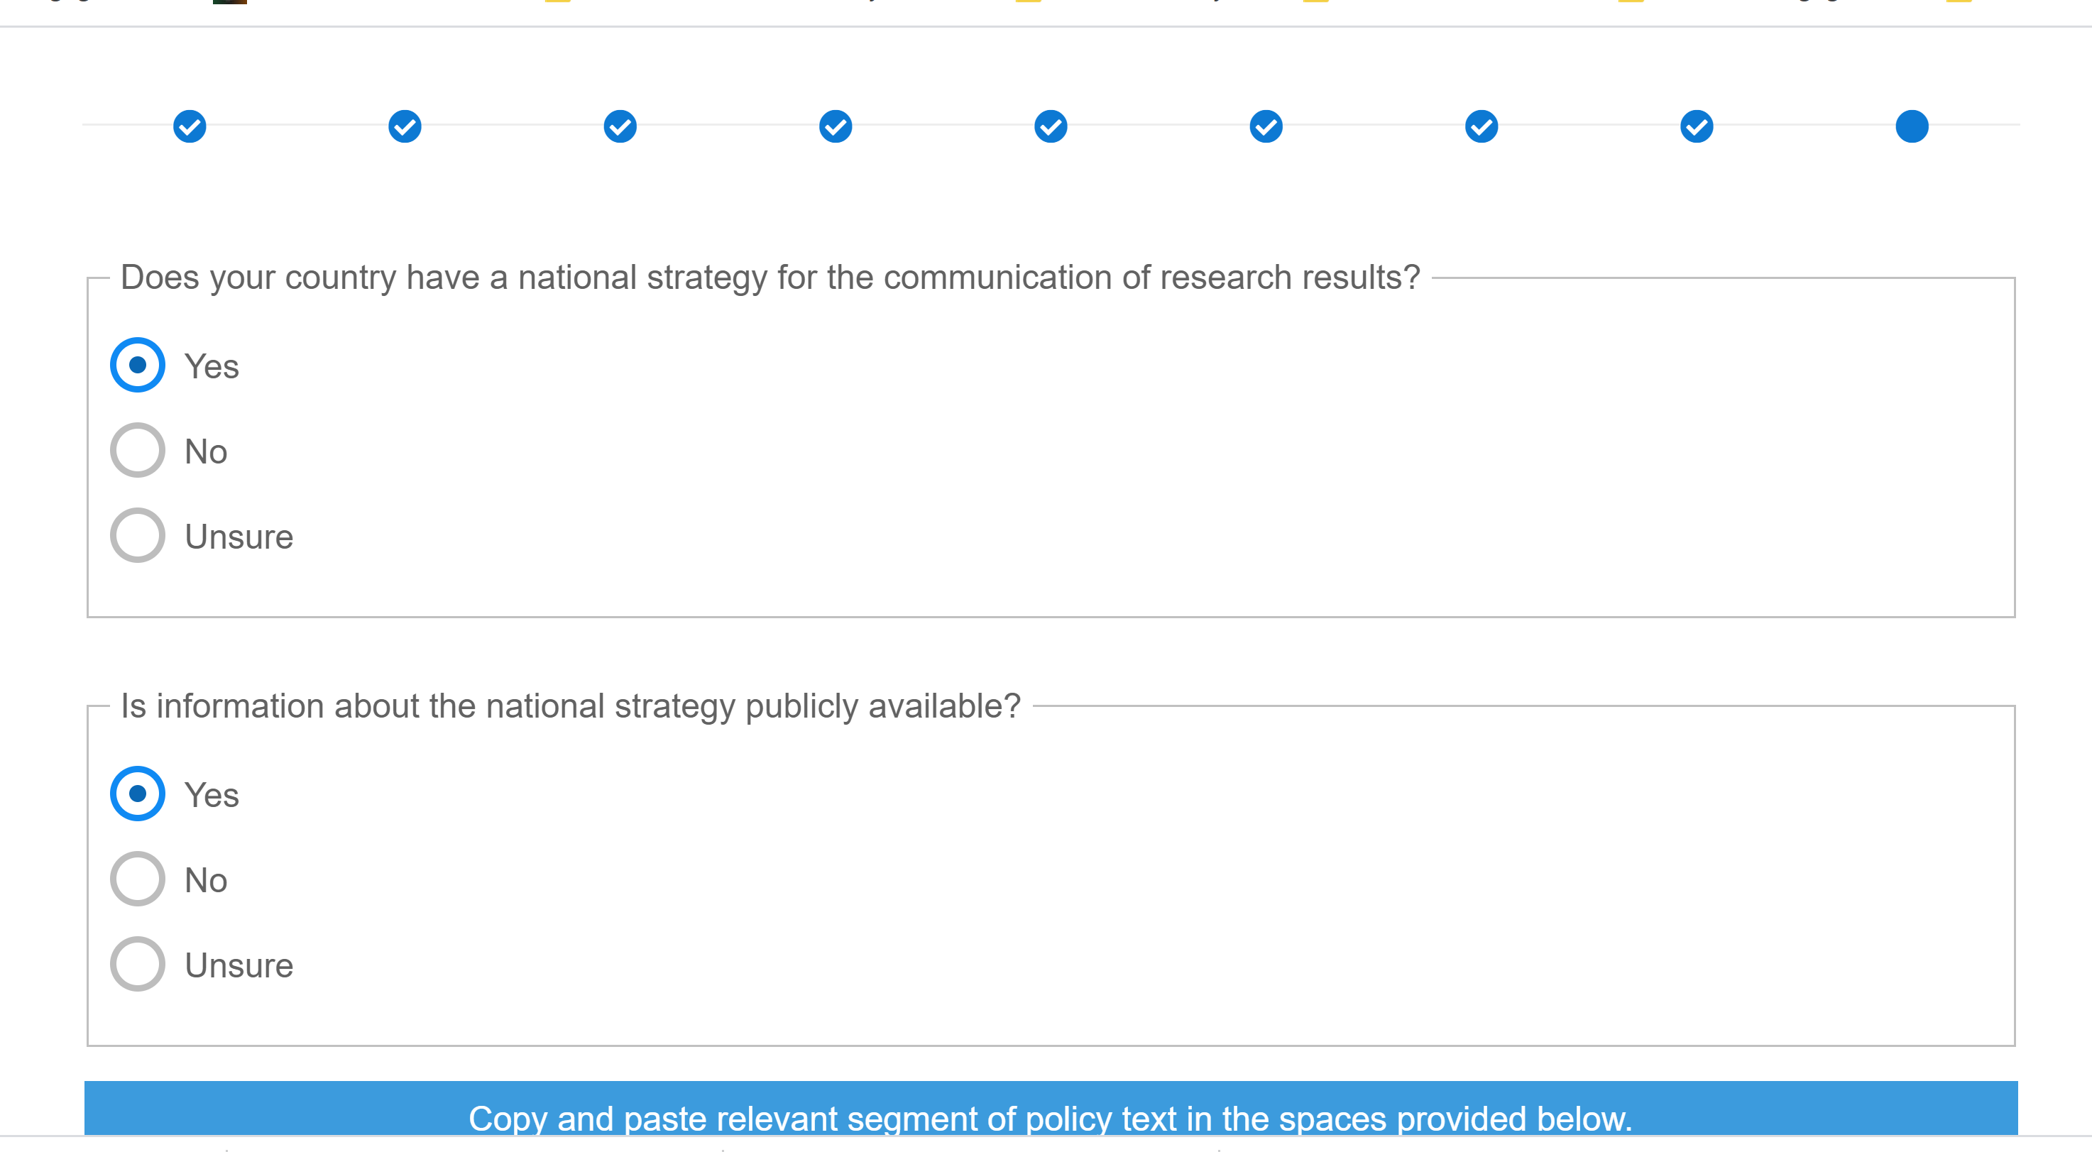
Surveys designed for subject matter experts on science, research and innovation policy within the Member State

Slide 31
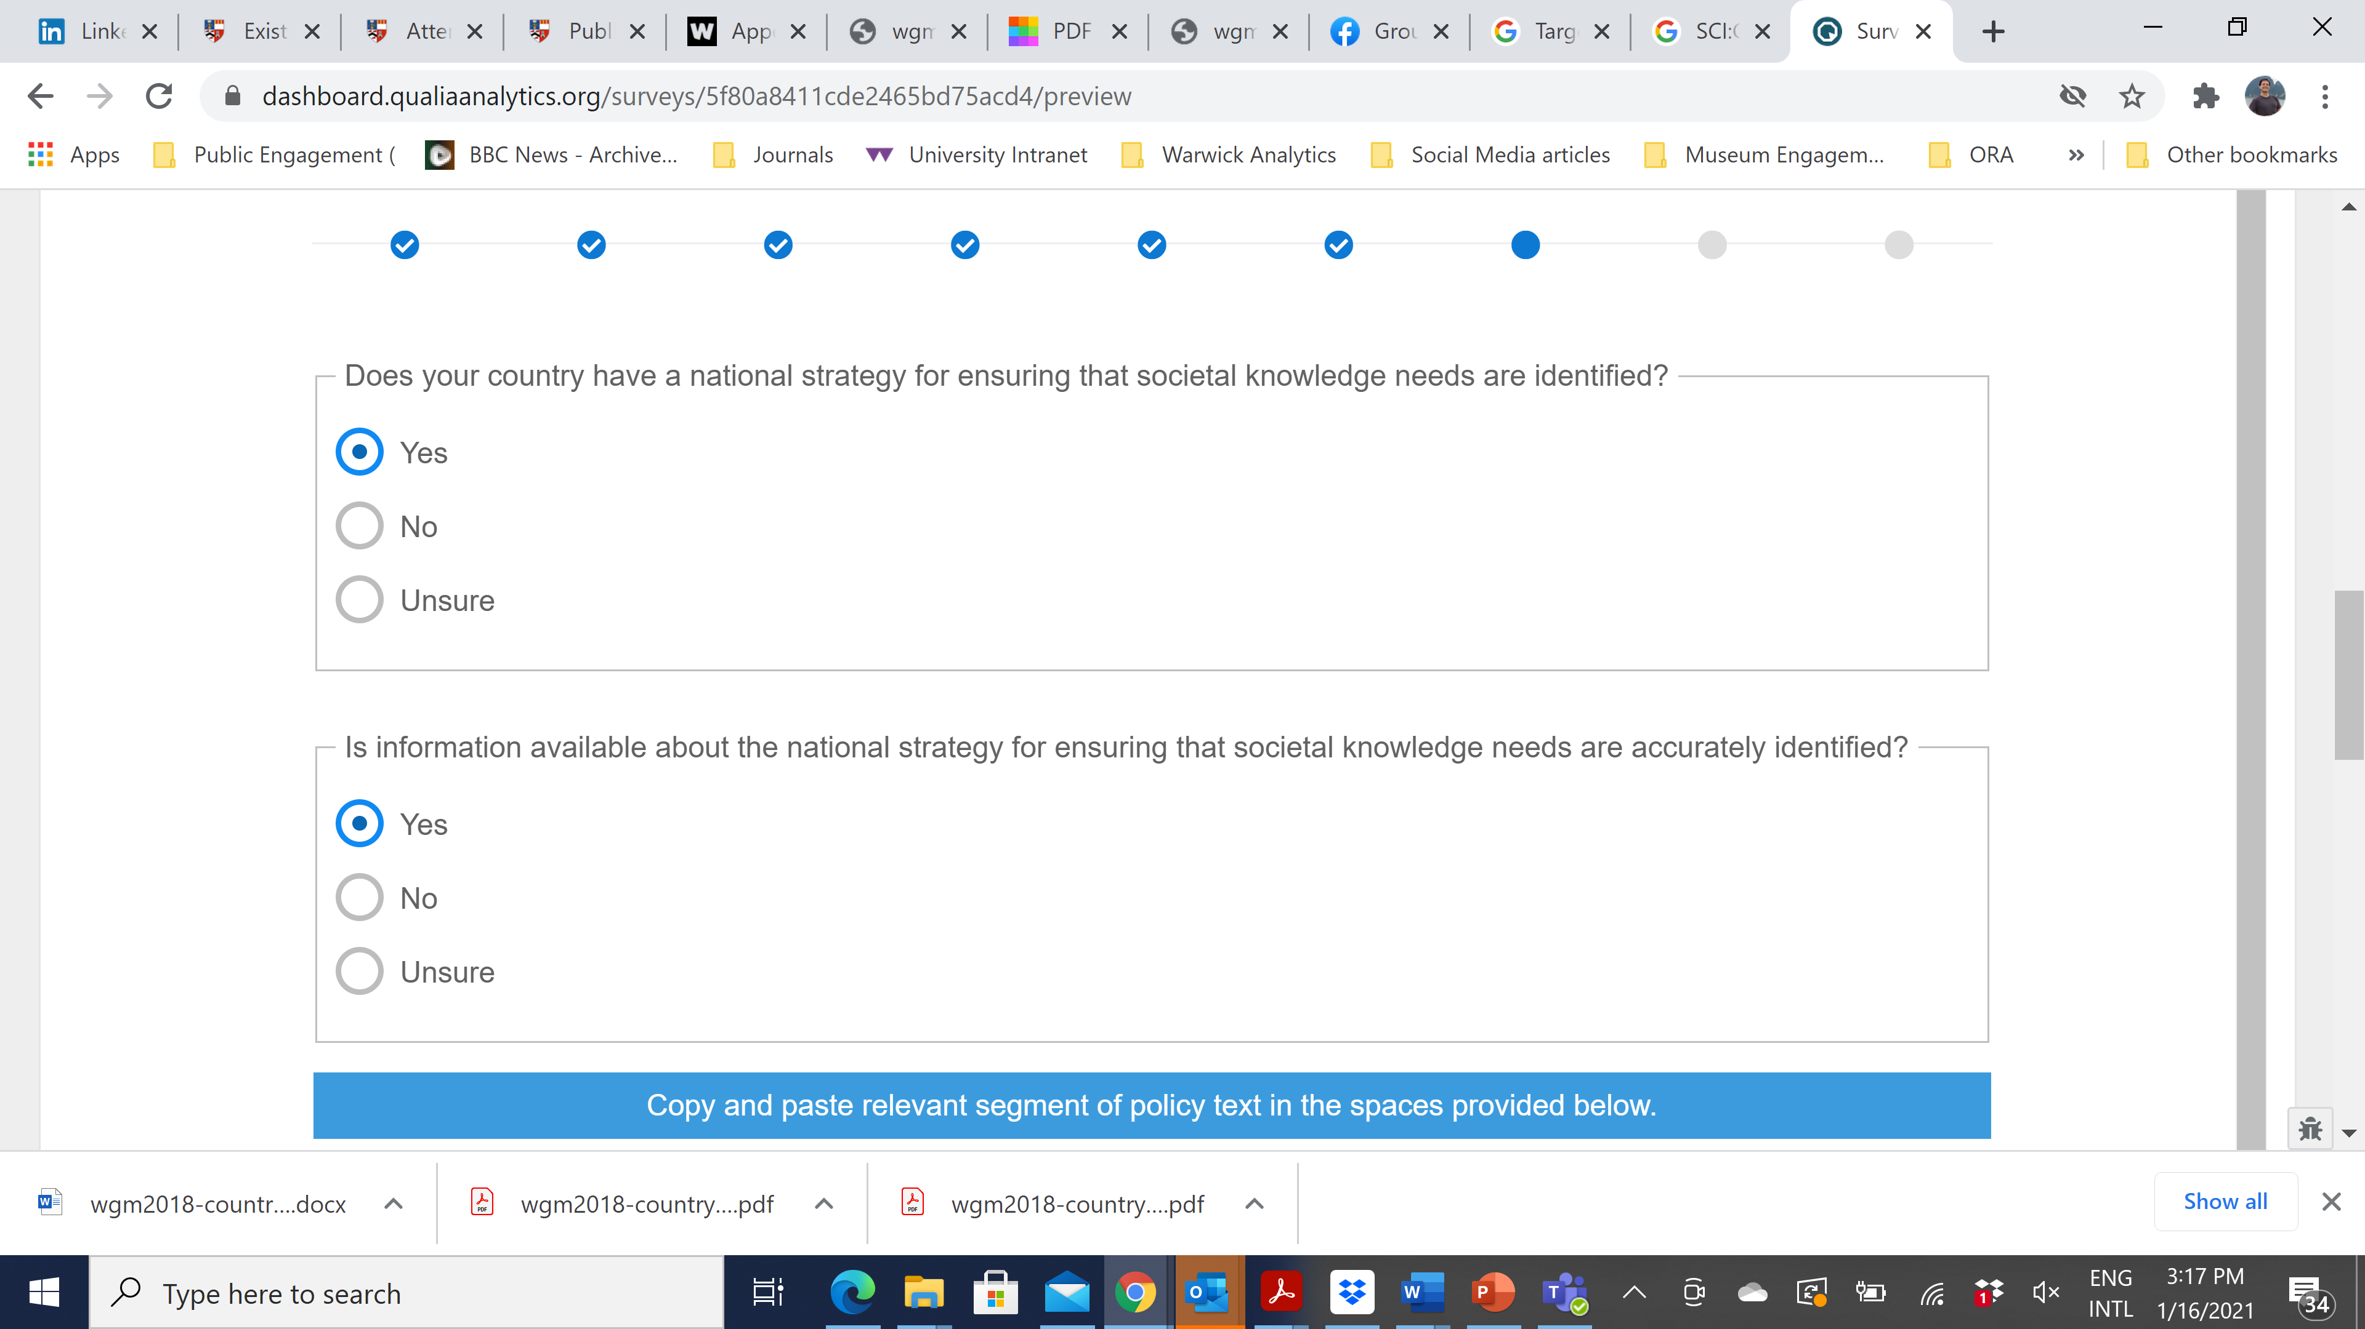
Surveys designed for subject matter experts on science, research and innovation policy within the Member State

Slide 32
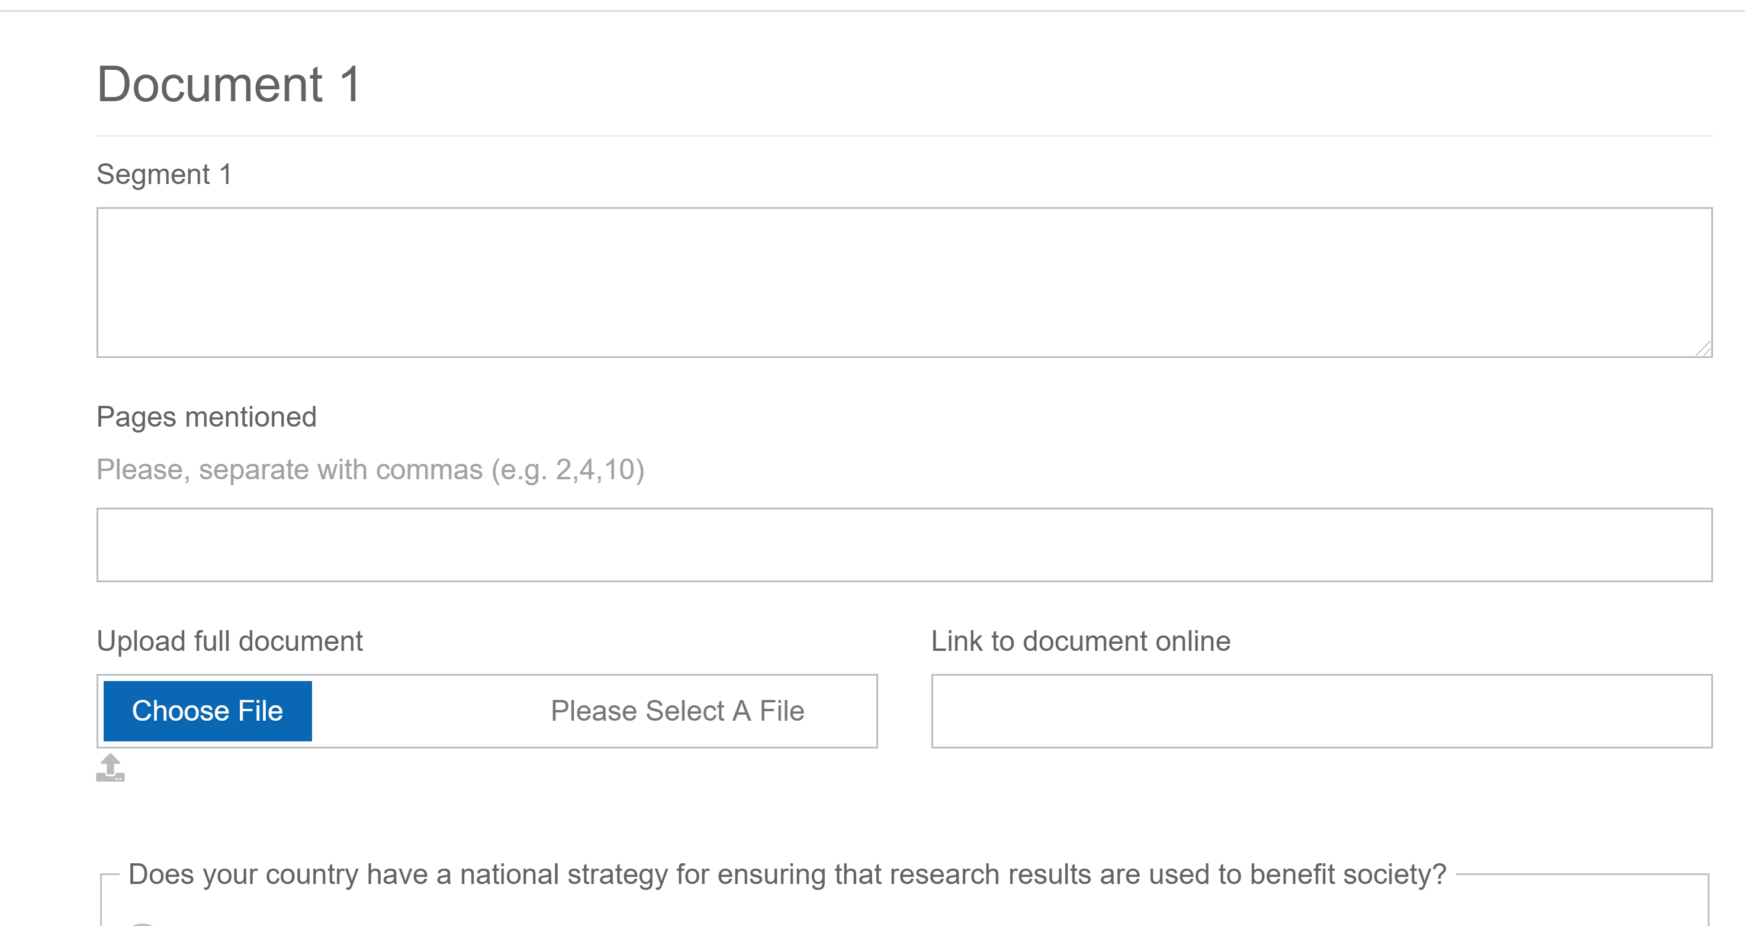
Surveys designed for subject matter experts on science, research and innovation policy within the Member State

Slide 33
Conclusion
Be targeted in your requests for information from subject matter experts.
Consider using digital surveys to gather the needed information efficiently and with precision.

Slide 34
UNESCO Recommendation on Science & Scientific Researchers
@JensenWarwick
Indicators for Public and Research Staff Levels of Measurement
IDENTIFYING RELEVANT EVIDENCE/INDICATORS FOR THE 10 KEY PRIORITY AREAS FOR MONITORING THE RECOMMENDATION’S IMPLEMENTATION
This project has received funding from the European Union’s Horizon 2020 research and innovation programme under grant agreement No 788503.

Slide 35
UNESCO Recommendation on Science and Scientific Reseachers: Using existing evidence
Need for evidence to underpin Member State reporting across the 10 Key Priority Areas
Can save money and deliver highest standard of evidence through strategic use of indicators drawn from international benchmark surveys

Slide 36
UNESCO Recommendation on Science and Scientific Reseachers: RRI Indicators
International survey data mapped against 10 Key Priority Areas for monitoring implementation of Recommendation on Science and Scientific Researchers
Offers benchmark data for RRI

Slide 37
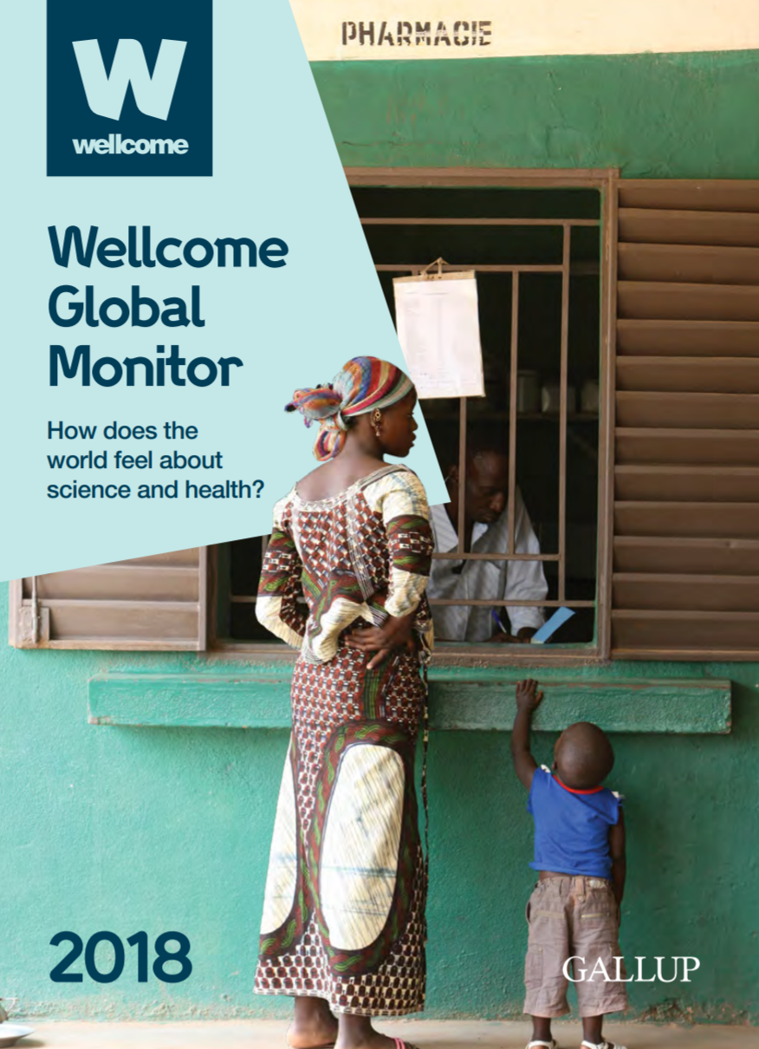
Data sources – General Public level of evidence
Geographic region | Country | Sample
North Africa | Algeria | 1,000
 | Egypt | 1,000
 | Libya | 1,003
 | Morocco | 1,001
 | Tunisia | 1,001
Middle East | Iraq | 1,000
 | Jordan | 1,002
 | Kuwait | 1,001
 | Lebanon | 1,000
 | Palestine | 1,000
 | Saudi Arabia | 1,016
 | Turkey | 1,000
 | United Arab Emirates | 1,005
 | Yemen | 1,000
WELLCOME GLOBAL MONITOR
140 countries
2018-19
Covers:
  Trust in science, scientists and scientific information
  Interest in science
  Perceptions of benefits of science
data collection by Gallup polling agency.

Slide 38
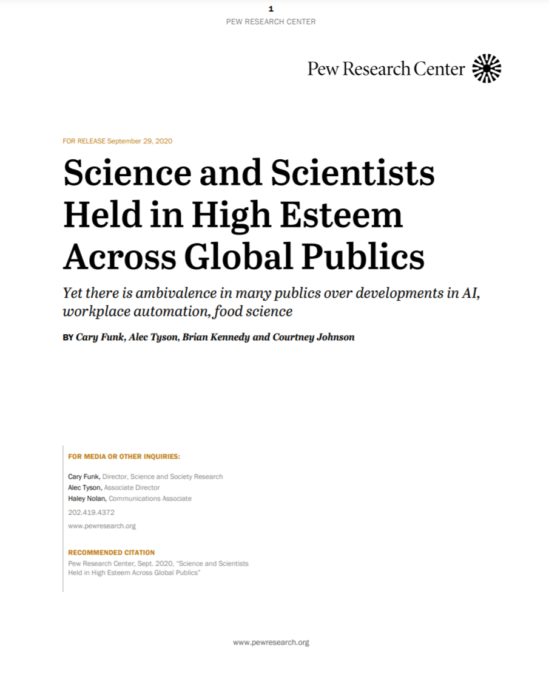
Data sources – General Public level of evidence
INTERNATIONAL SCIENCE SURVEY (Pew ISSQ)
Covers:
  level of trust in scientists
  public understanding of science news
  support of government investment in scientific research, etc.
Conducted across 20 countries
  Europe, Russia, the Americas and Asia-Pacific
October 1, 2019 to March 15, 2020.

Slide 39
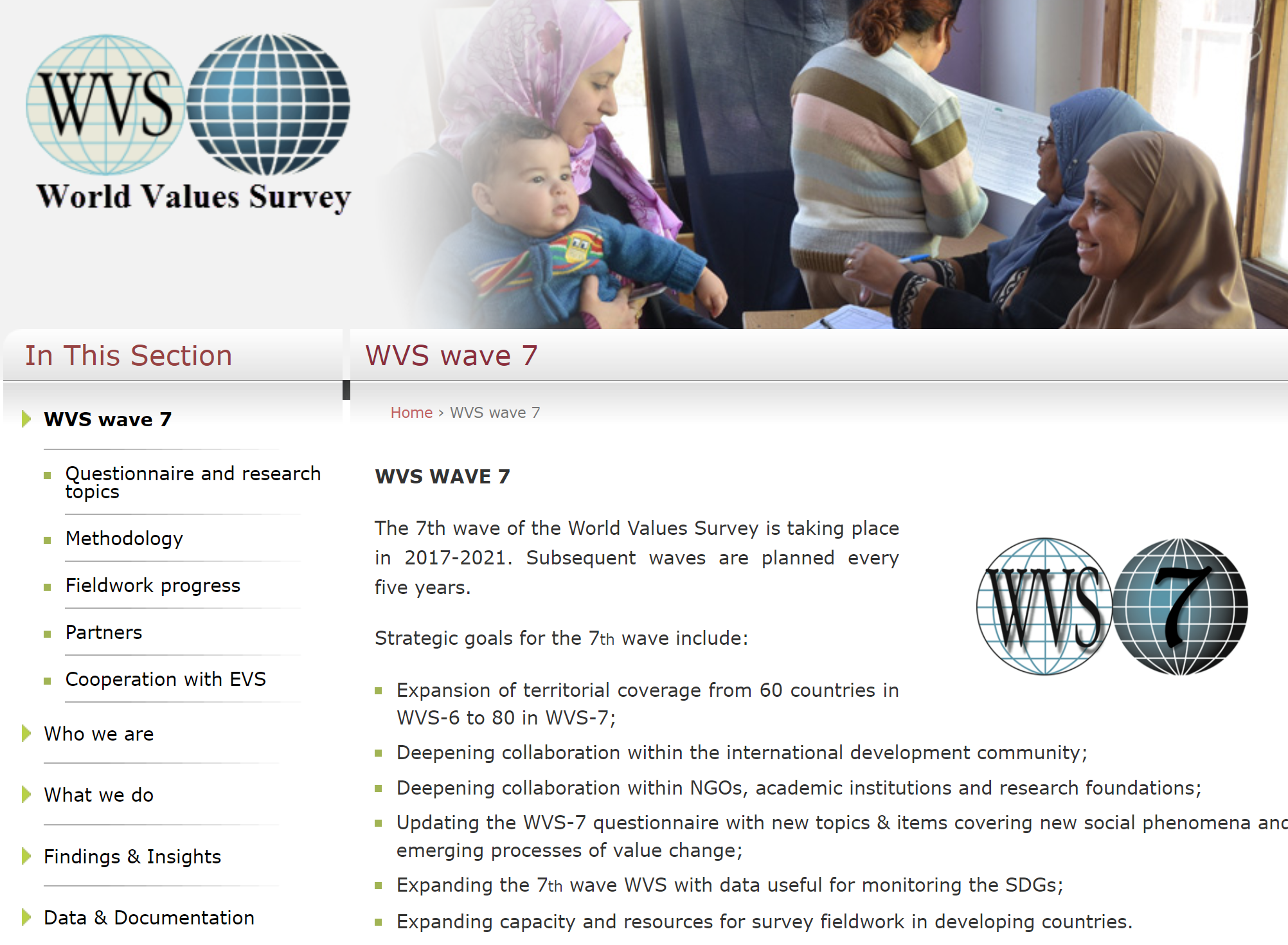
Data sources – General Public level of evidence
Notes:
WORLD VALUES SURVEY (WVS)
Over 70,867 respondents of 49 countries and societies over the age of 18 were interviewed.
It covers topics such as cultural values, attitudes and beliefs towards gender, family, and religion; attitudes and experience of poverty; education, health, and security; social tolerance and trust, attitudes towards multilateral institutions cultural differences and similarities between regions and societies.
The study started in early 2017 and concluded in mid-2020.

Slide 40
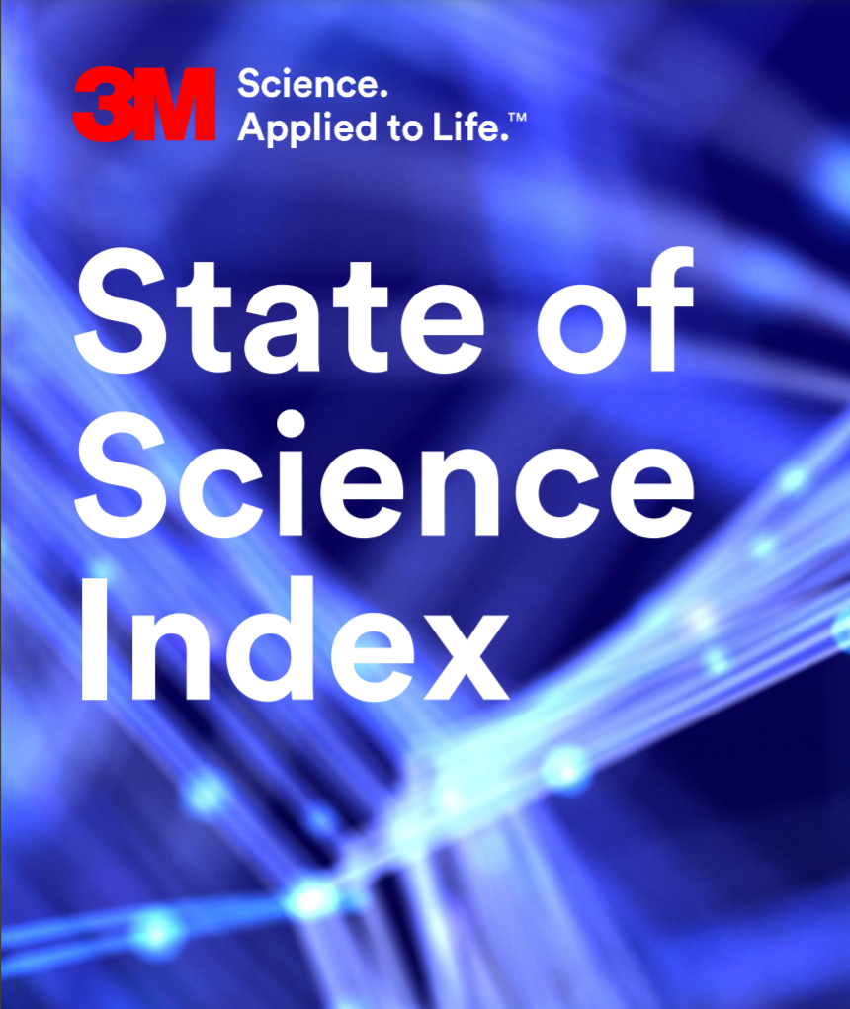
Data sources – Public level
Notes:
3M STATE OF SCIENCE INDEX SURVEY
For the last three years, 3M has launched the annual State of Science Index to track attitudes to science through multi-country original research.
The 2018 survey was conducted across 14 countries from June 14 to August 26, 2017. Globally, 14,036 people were interviewed.
The 2019 survey was conducted across 14 countries from July 13 to September 10, 2018. Globally, 14,025 people were interviewed.
The 2020 survey was conducted across 14 countries in August-October 2019. Globally, 14,105 people were interviewed.

Slide 41
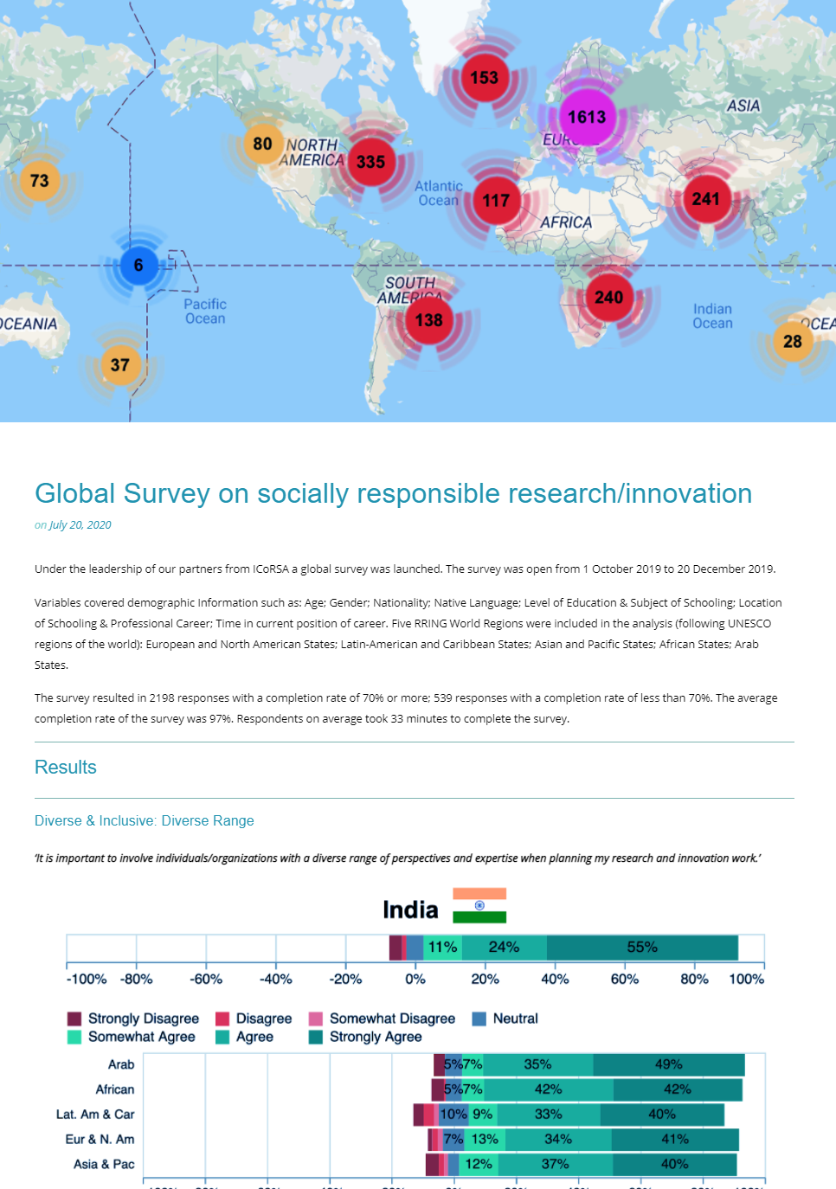
Data sources – Research Staff level of evidence
RRING SURVEY ON SOCIALLY RESPONSIBLE RESEARCH/INNOVATION
The survey was open from 1 October 2019 to 20 December 2019 and it was conducted across 20 countries of the world.
The objective was to get a deeper insight into the practices and policies of Responsible Research and Innovation (RRI) across the world.
The survey resulted in 2,198 responses.

Slide 42
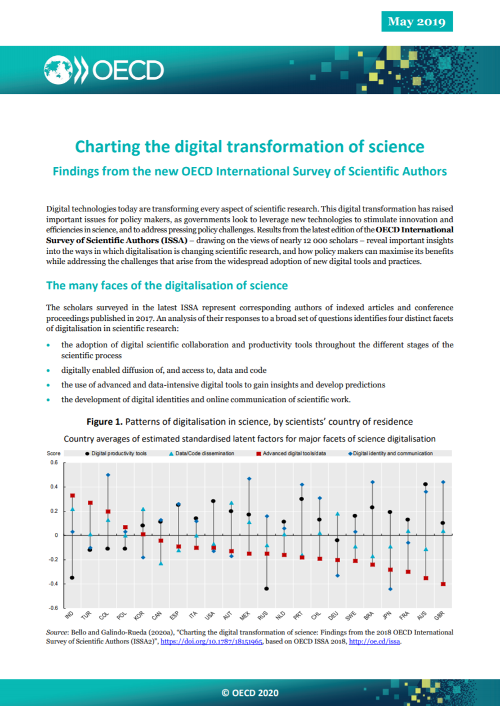
Data sources – Individual Researchers
OECD INTERNATIONAL SURVEY OF SCIENTIFIC AUTHORS
n=12,000 researchers.
Global sample covering all disciplines.

Slide 43
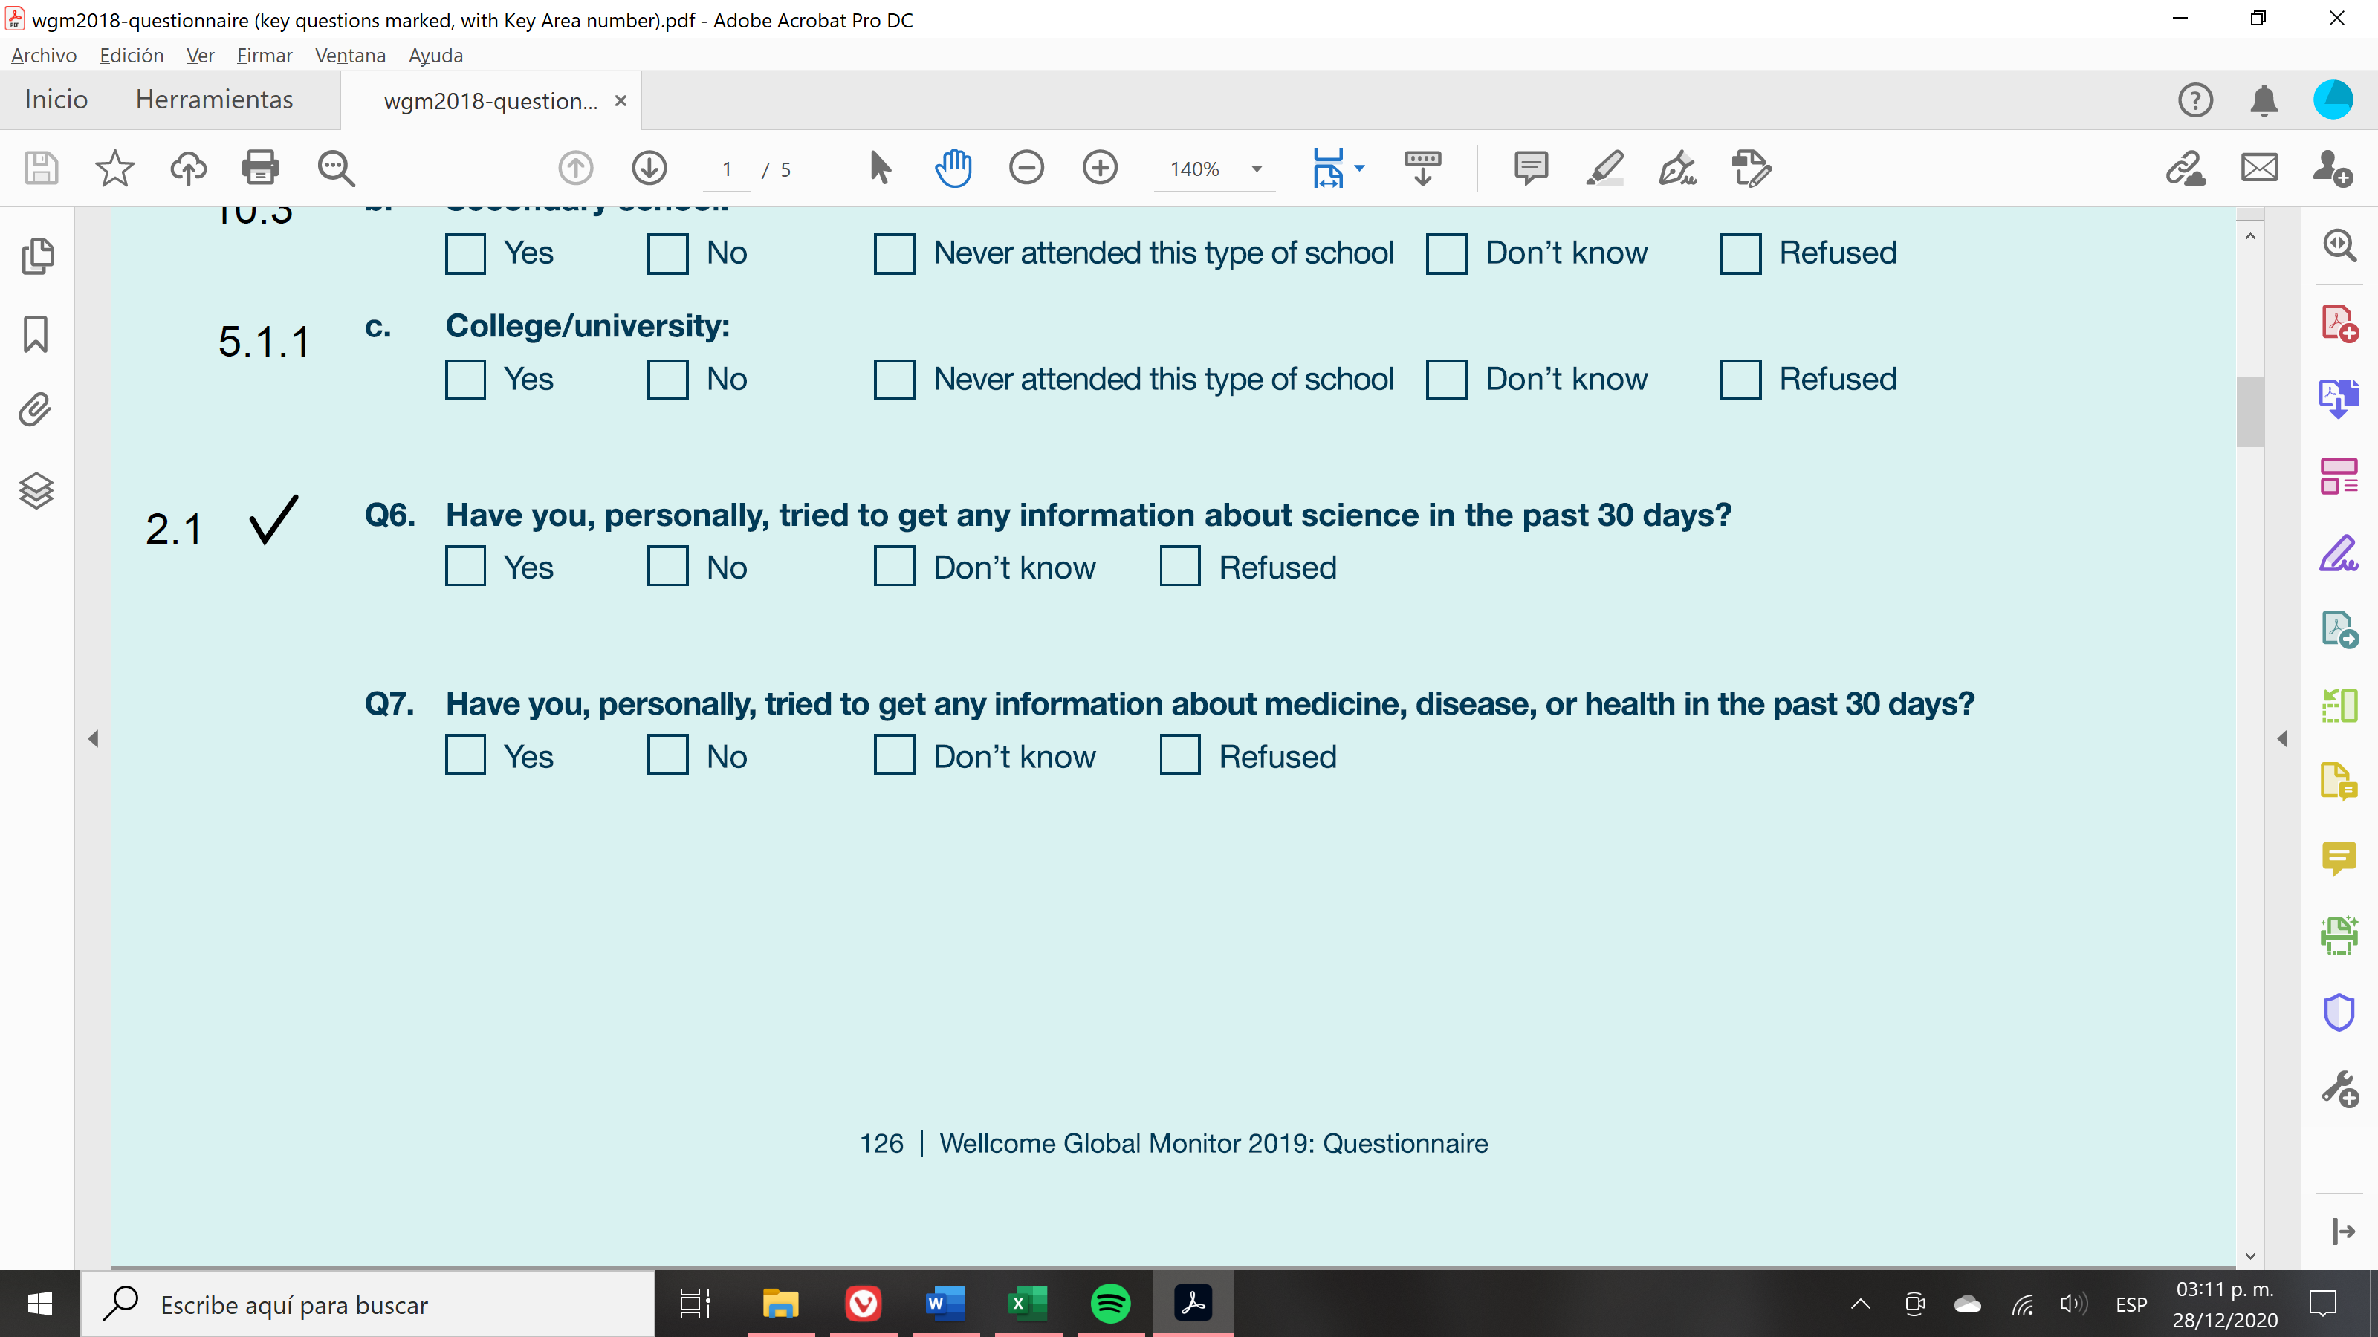
EXAMPLES - General Public level of evidence
KPA 2.1 - Member States’ governments and the general public alike recognise value and use of science and technology for tackling global challenges
Question #6 (WGM survey 2018) evaluates interest of public in obtaining information about science.
Results from this survey question indicate whether the general public sees value in science.
Question #6 from the Wellcome Global Monitor Survey 2018

Slide 44
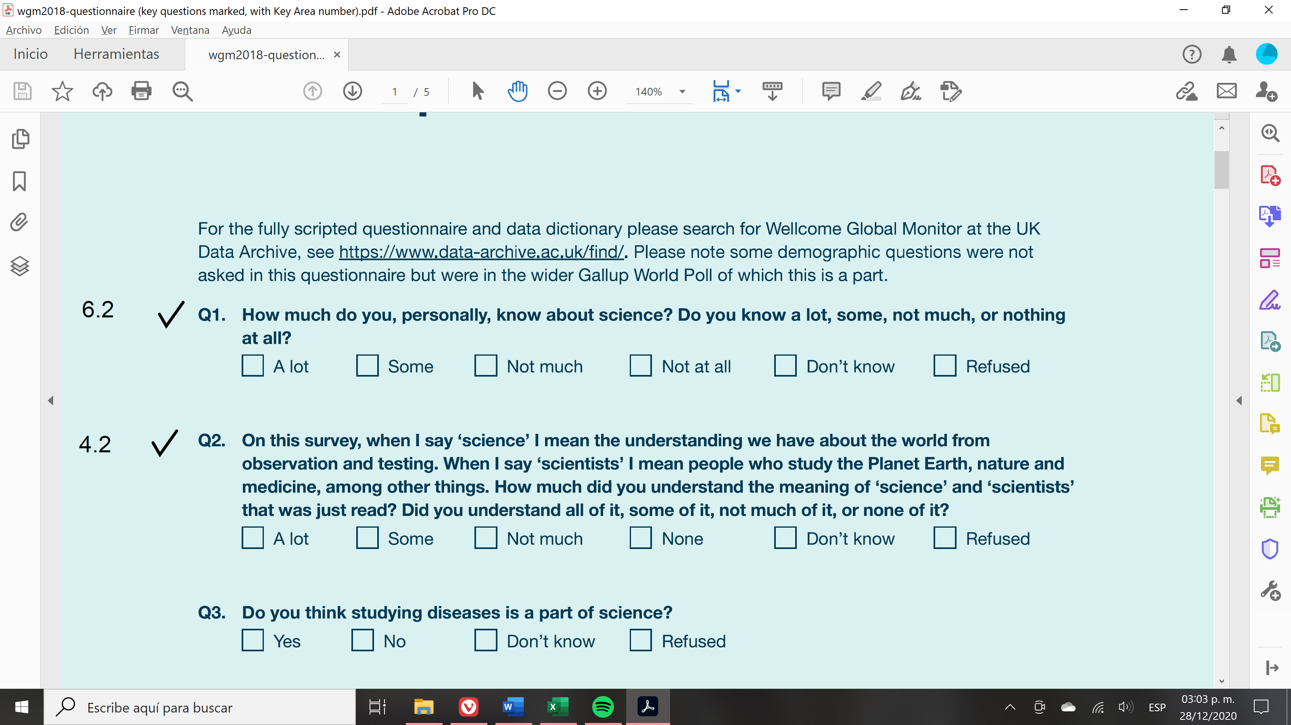
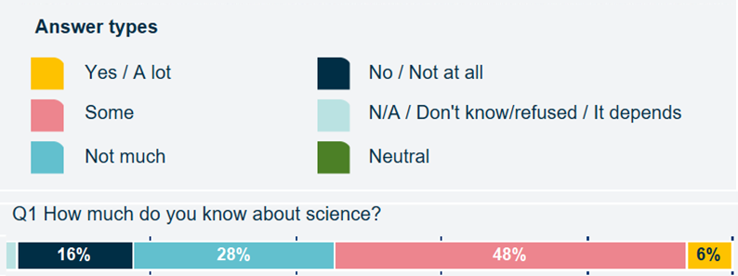
Examples of General Public level indicators
Question #1 from the Wellcome Global Monitor Survey 2018
KPA 6.2.1 Promote human right to share scientific advancement and its benefits
Question #1 from WGM survey 2018 evaluates how much the public feels they know about science.
*Extracted from Serbia country report

Slide 45
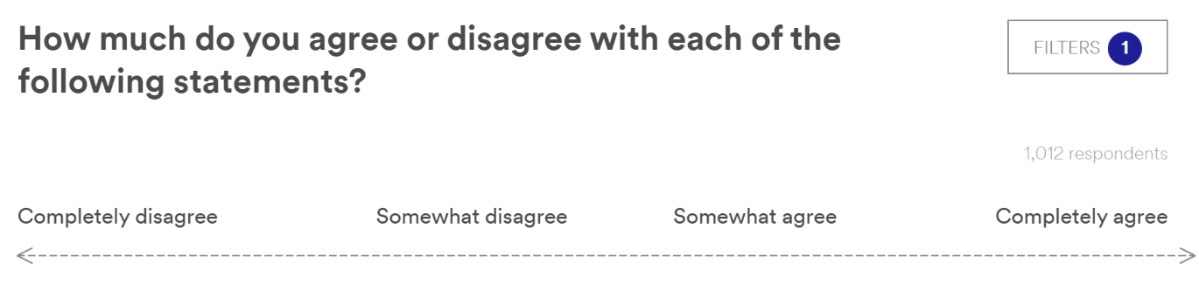
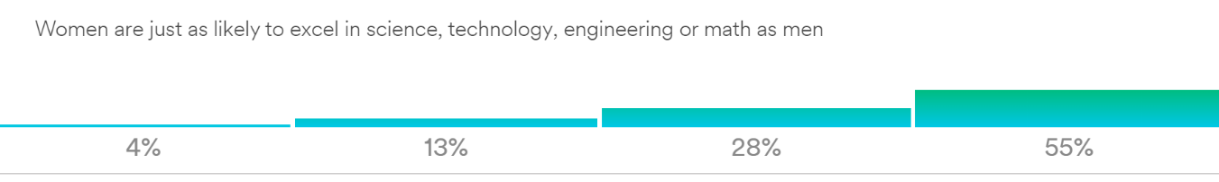
EXAMPLES - General Public level of evidence
KPA 5.3.1 - Encourage women’s participation in scientific research work
Question #26 from 3M State of Science survey 2020 assesses perception of women’s ability to succeed as scientists when compared to men.
Indicator: Progress in assuring equal opportunities for scientific research careers on basis of gender.
Question #26: 3M State of Science survey 2020
‘Women are just as likely to excel in science, technology, engineering or math as men’
*Extracted from South Africa country report

Slide 46
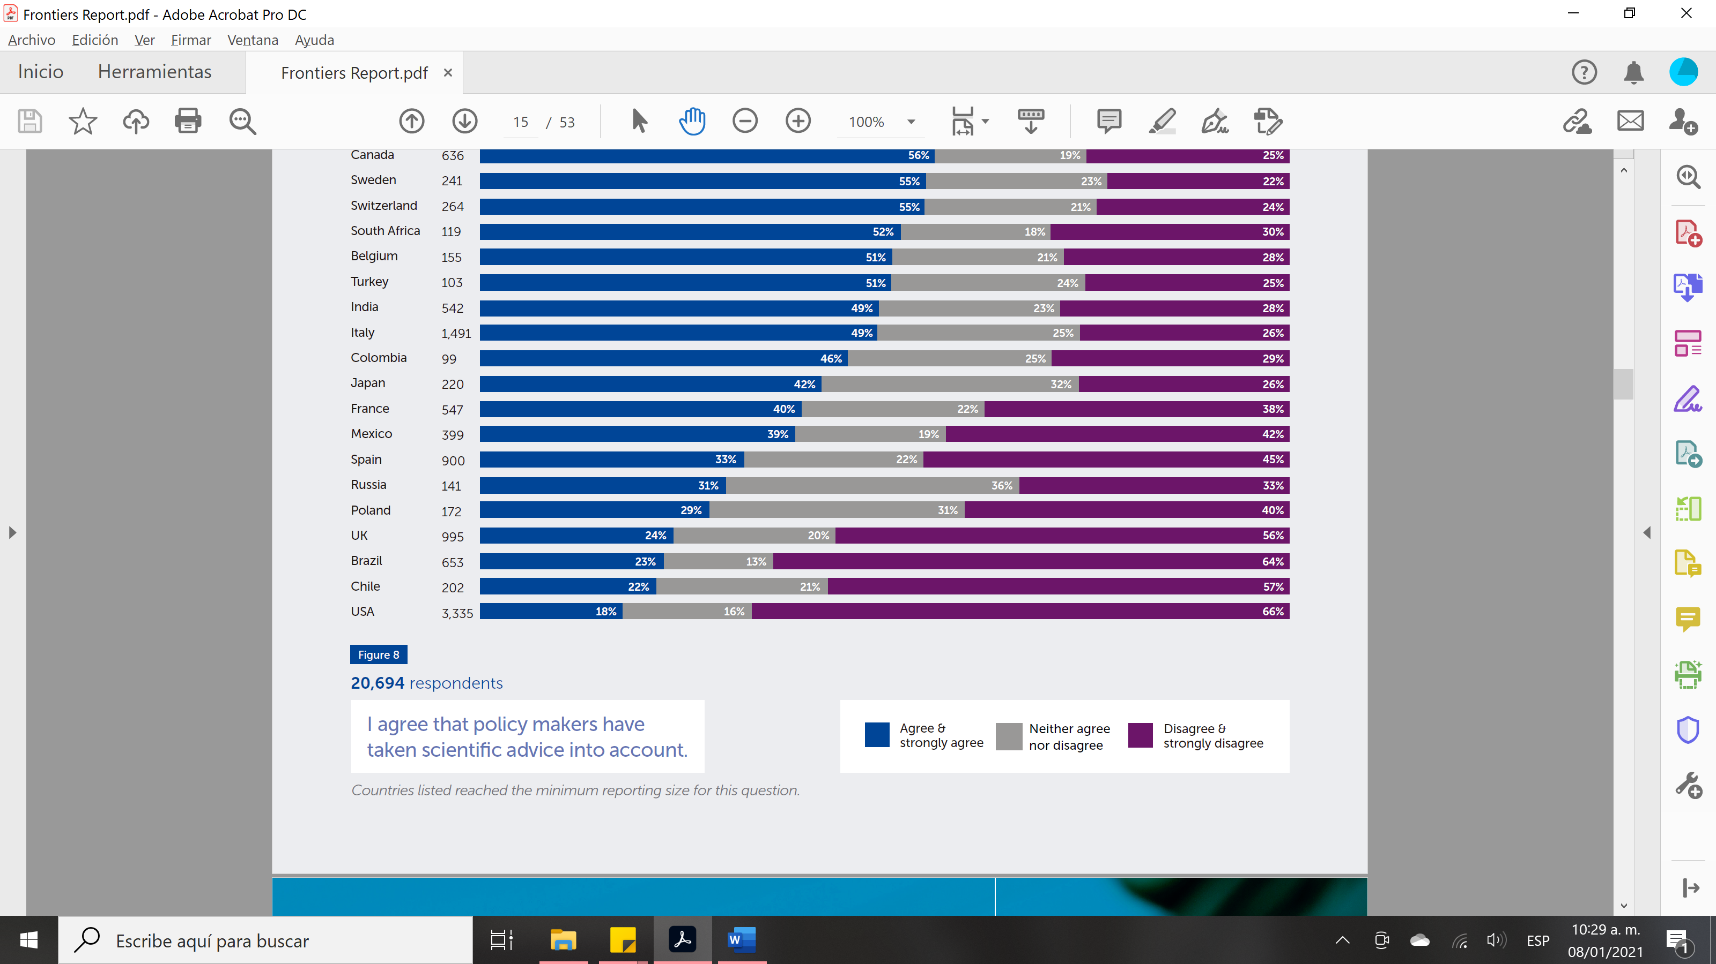
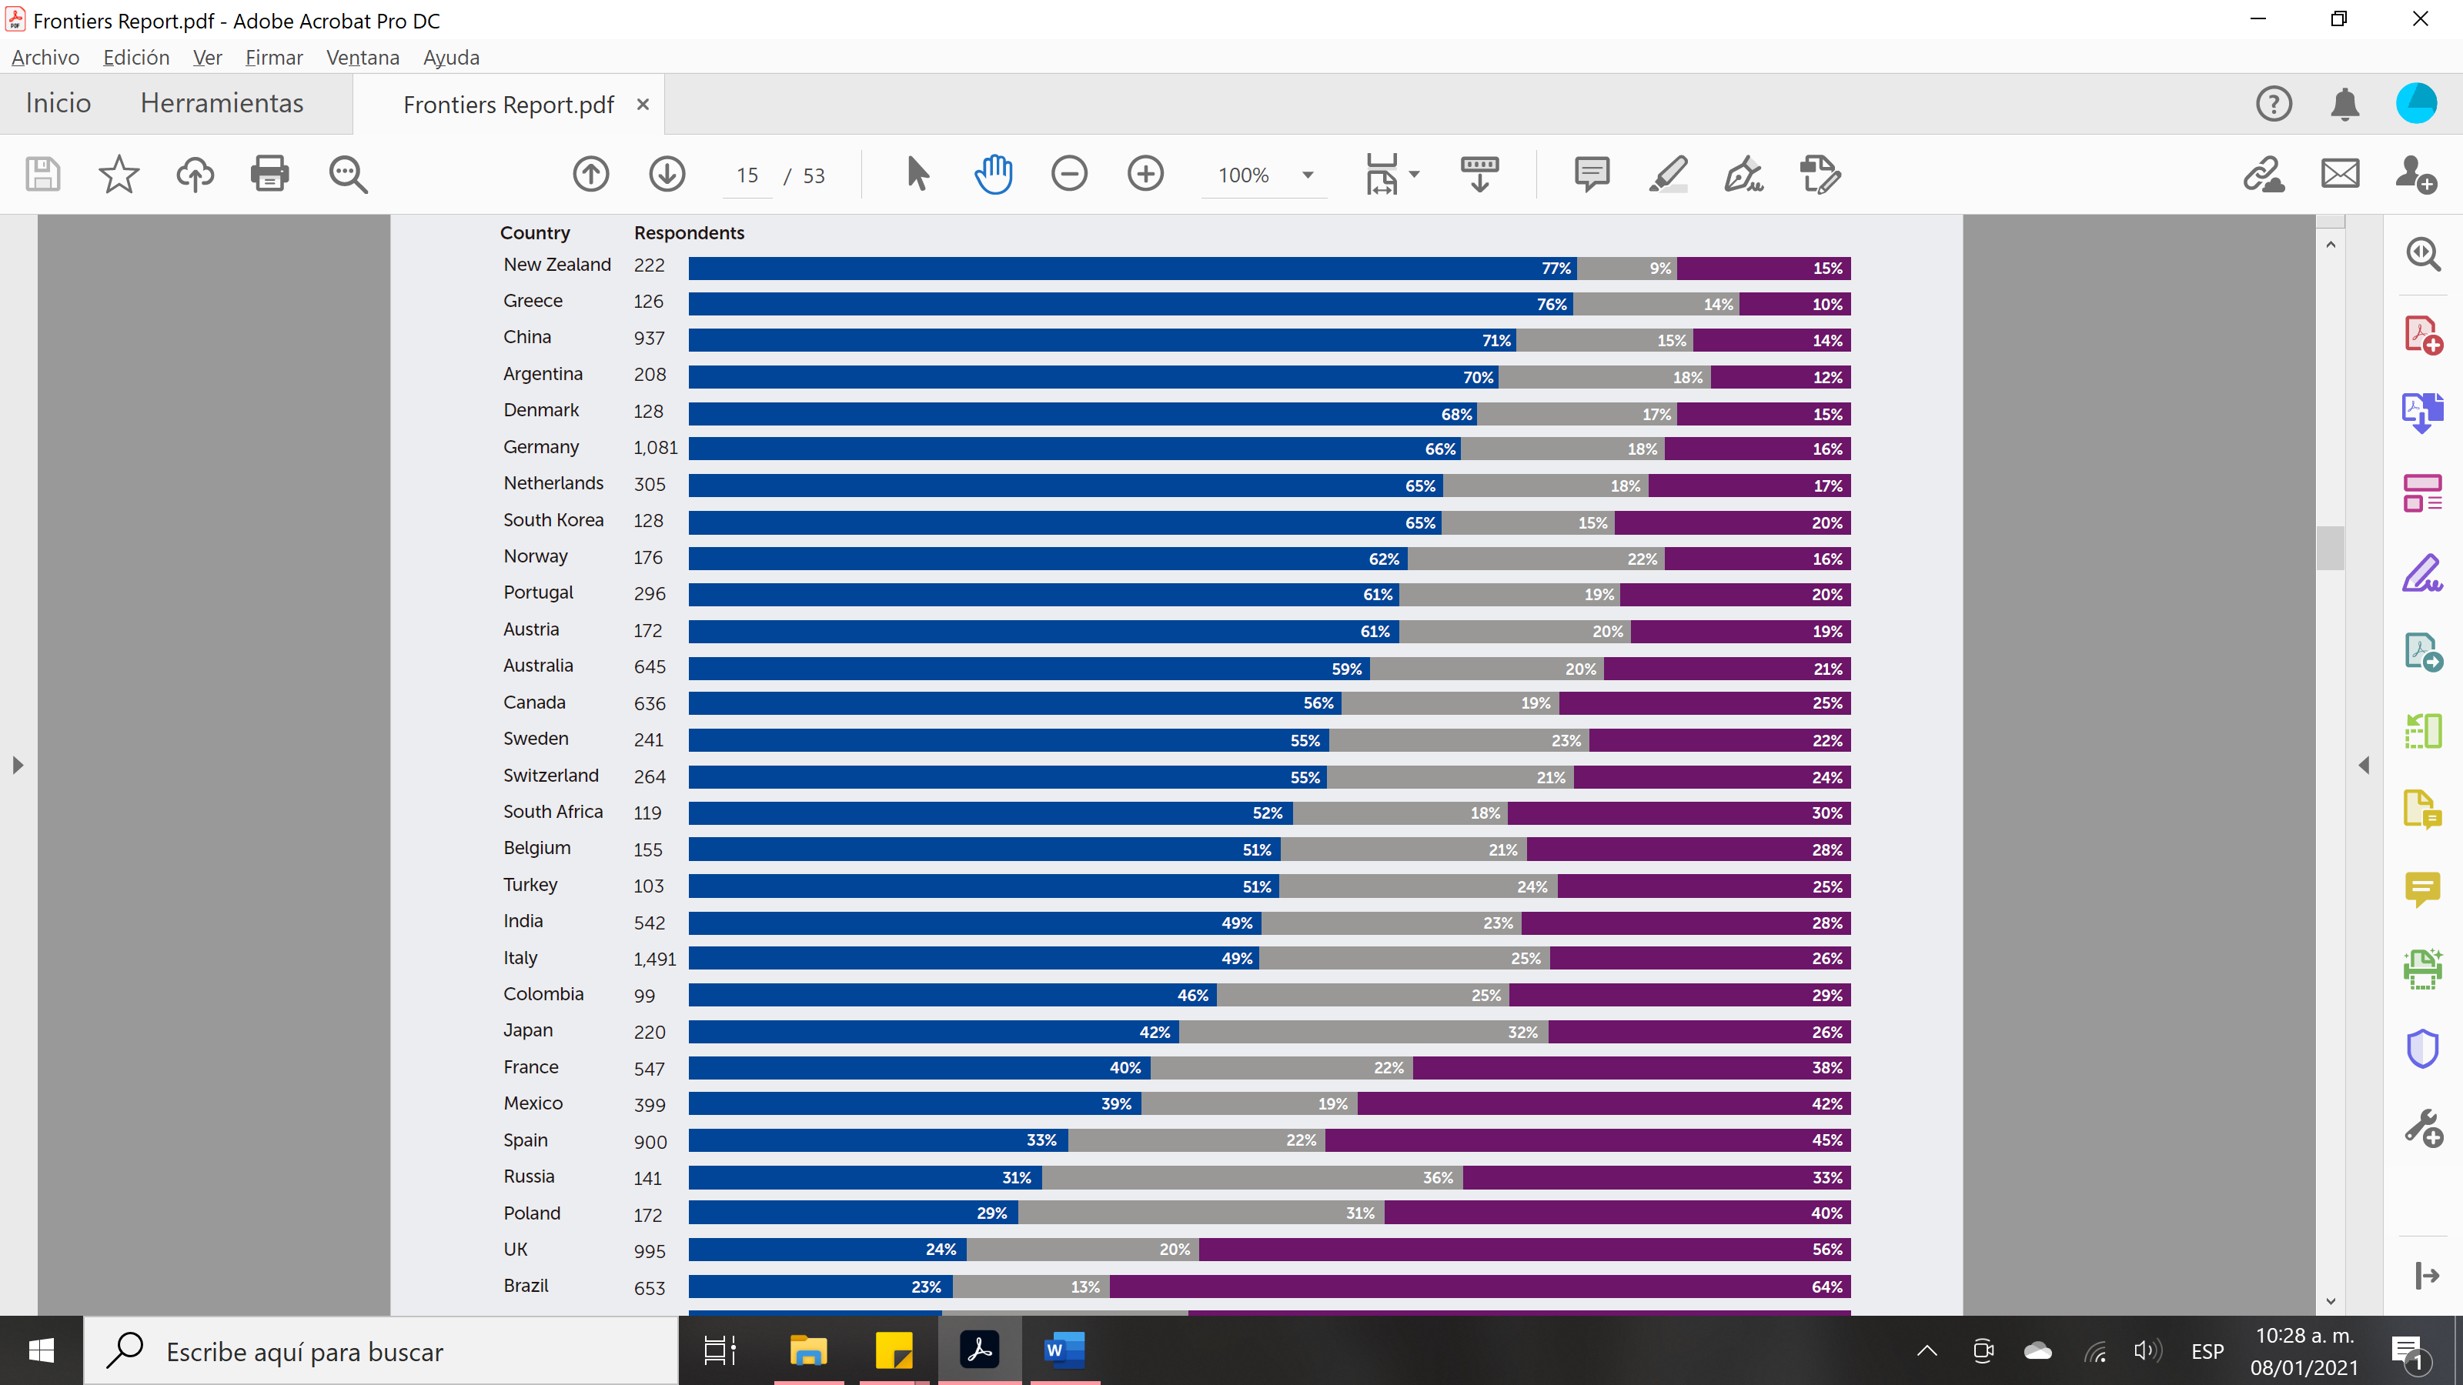
EXAMPLES – Research staff level of evidence
Question from Frontiers’ Academic response to COVID-19 survey
KPA 3.1 Using scientific knowledge to inform national policy and decision-making in an inclusive and accountable manner
This question assess researchers’ perception of whether policy makers have taken scientific advice into account sufficiently, focusing on the period of the present pandemic.
*Extracted from South Africa country report

Slide 47
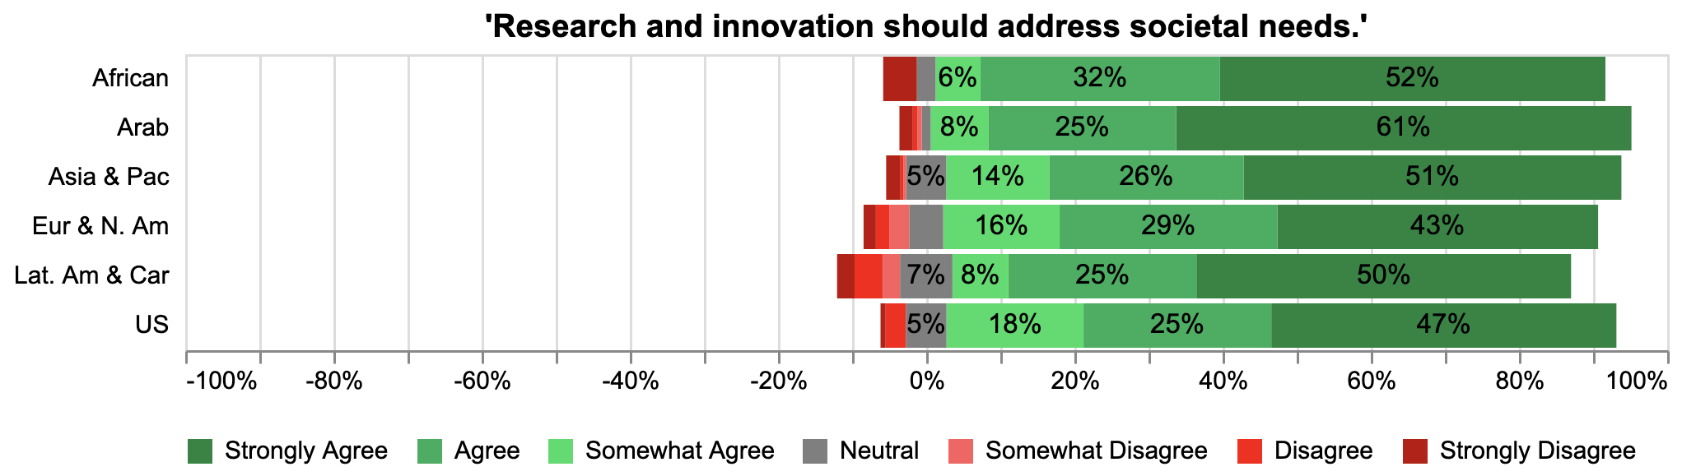
    Global Researcher Survey Results (rring.eu)
    Responsive to
    Societal Needs
'Research and innovation should address societal needs.'
n=2224
[African=193, Arab=164, Asia & Pac=257, Eur & N. Am=1255, Lat. Am & Car=210, US=145]
Overall sentiment leaning heavily on agreement

Slide 48
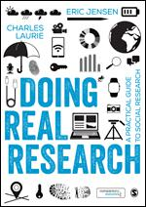

Dr. Eric A. Jensen – e.jensen@warwick.ac.uk
@JensenWarwick
Training on impact evaluation available
Methodsforchange.org

Slide 49
Impact of Science
23-25 June, 2021
Alan Paic
Senior Policy Analyst at Organisation for Economic Co-operation and Development (OECD), France
#IOS21

Slide 50
Evaluation OF science beyond bibliometrics
Alan Paic
OECD Science, Technology and Innovation
AESIS
24 June 2021

Slide 51
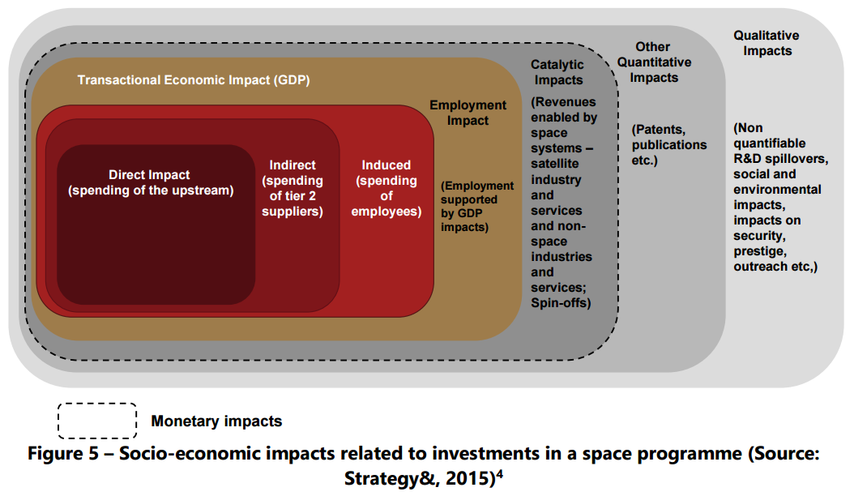
What is research impact?
A consultant’s view

Slide 52
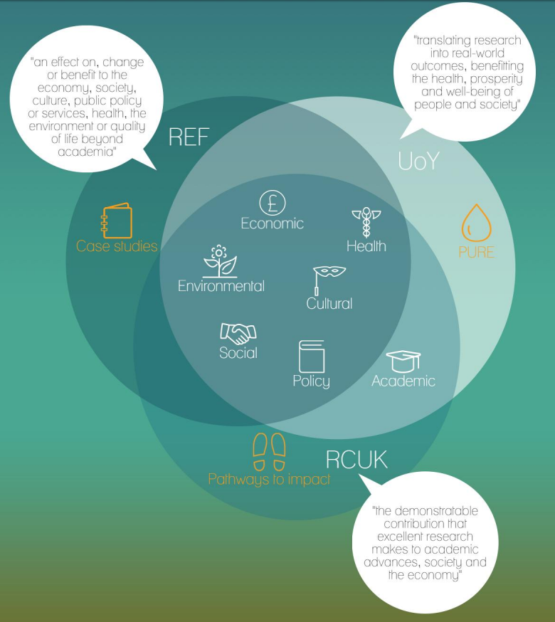
What is research impact?
UK academic, policy maker & funder view

Slide 53
The complexity of impact
– no linear model!
Agenda setting
R&D
Outputs
Outcomes
Impacts
Needs, Demand
Infrastructure, facilities for research
Trained people (PhDs etc)
New disciplines and technologies
Changed policies, regulations
Changed knowledge networks
Changed education
Agenda-setting in research (can cause lock-in)
Economic spillovers, diffusion in the economy and society
R&D activities
Advice for policy or regulation
New products, processes, services
Economic and social development; growth
R&D coordination mechanisms (road maps, methodologies, standards, etc)
More, riskier R&D, combating market failure, creating additionalites
Research outputs (papers, proceedings, courses ..)
Reconfigurations of the fabric or institutions of R&D
Knowledge spillover to other policies
Intermediate knowledge product (discoveries, concepts, tools, techniques, methods, technologies
Institutional reforms (addressing systems failures)
Changed character of products and processes, (eg ‘greener’)
Agenda-setting in markets; market intelligence
Improved technological capabilities and competitiveness of firms
Intermediate innovation products (feasibility, prototypes, demonstrations … )
Scientific and technological opportunities – both new and existing in the stock of knowledge
Source: Technopolis

Slide 54
Four main groups of impacts to be considered
Productivity
Sustainable Development Goals
Human capital
Societal challenges
Public policy and parliamentary debate
« science for policy »
« policy for science »
Impact

Slide 55
R&D influence on productivity
Guellec and van Pottelsberghe de la Potterie, 2001, 2004 find that knowledge created through R&D performed by businesses, the public sector and foreign firms is a determinant of long-term productivity growth.
Bravo-Ortega and Garcıa Marın (2011), using a panel of 65 countries over 1965–2005 period, indicate that: ‘‘a 10% increase in R&D per capita generates an average increase of about 1.6% in the long-run TFP’’
Coccia (2012) finds a very likely positive correlation (r=63%), across some advanced countries, between labor productivity growth and private R&D expenditure higher than public R&D expenditure.
D’Artis and Siliverstovs (2016) find non-linear effects of R&D on productivity growth: “the estimated productivity elasticity ranges from −0.02 for low levels of R&D intensity to 0.33 for high levels of R&D intensity; only after a certain critical mass of knowledge is accumulated, is the productivity growth significantly positive; […] firms in high-tech sectors not only invest more in R&D, but also achieve more in terms of productivity gains connected with research activities.
Coccia (2017) finds that the optimal level of R&D intensity is 2.5% of GDP and tax on corporate profits of 3.1% of GDP to maximize the labor productivity of nations.

Slide 56




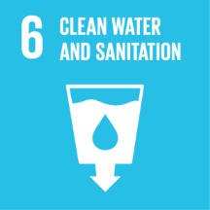

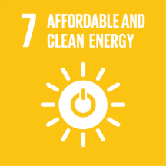
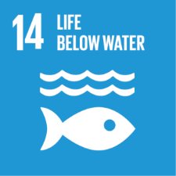

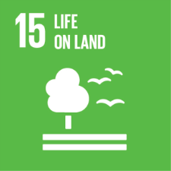
Impact on societal challenges
Example: Biotechnology impact on the SDGs
Sustainable and resilient crops
Enhancing crop yields
Meat and dairy substitutes
‘Bio-principled cities’ based on local recycling processes for waste, closed material and energy cycles
Biopharmaceuticals and microbiome-based approaches for diseases such as malaria, diabetes and obesity
Human aging
Mental disease
Bio-based materials and chemicals (e.g. bioplastics
Circular economy research, e.g. biorefining, bioproduction
Biological wastewater treatment, including phosphorus removal and nitrification
Carbon capture: transforming CO2 into bio-based chemicals and fuels
Development of drought-resistant crops through genetic engineering
Development of biofuels (cellulosic, algal, biogas from waste…)
Decentralized, modern solutions that combine bioenergy with other renewables (mitigating intermittency)
Sustainable fishing through genetic markers
Job creation in the bioeconomy
USD 178 per USD 1 invested in the Human Genome project
Bioengineering of self-fertilizing food staples (maize, wheat, barley, rice)
Forest genomics
Advanced breeding technologies to avoid soil exhaustion and degradation
Source: OECD collaboration including inputs from Alan Paic, James Philp and David Winickoff

Slide 57
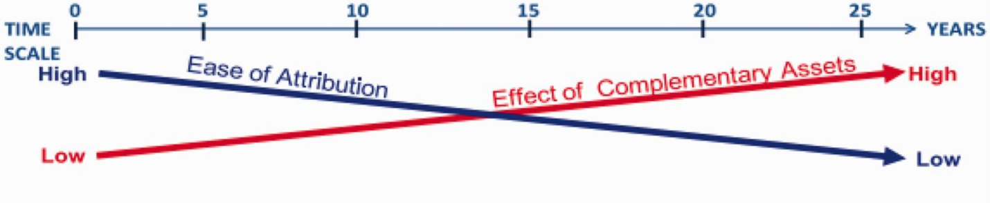
A measurement problem
From: Assessment, evaluations, and definitions of research impact: A review
Res Eval. 2013;23(1):21-32. doi:10.1093/reseval/rvt021

Slide 58
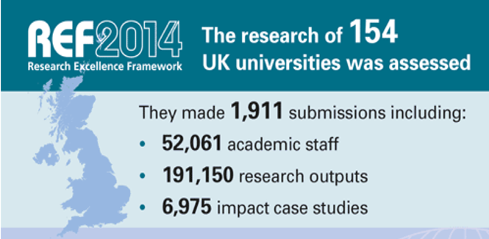
Societal impact of science measured by a case study method
King’s College London and Digital Science, 2015

Slide 59
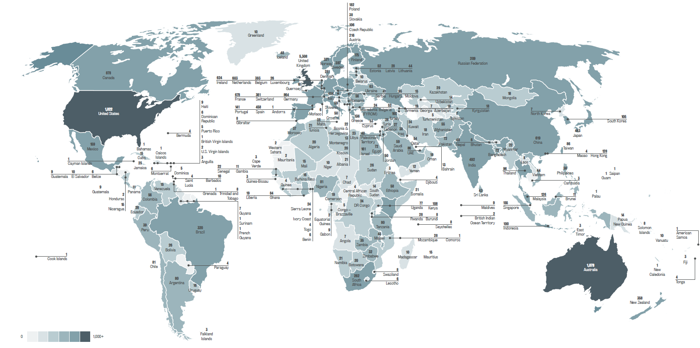
The impact of UK research is global
King’s College London and Digital Science, 2015

Slide 60
The distribution of impacts varies according to discipline
Discipline | Impact Type
 | Political | Legal | Cultural | Societal | Economic | Health | Technological | Environmental
Mathematics | 22 | 1 | 8 | 39 | 55 | 24 | 211 | 44
Physics | 3 | 0 | 6 | 42 | 7 | 9 | 176 | 5
Chemistry | 7 | 1 | 6 | 15 | 15 | 3 | 271 | 27
ICT | 16 | 7 | 60 | 106 | 56 | 10 | 363 | 12
Technology | 0 | 1 | 0 | 7 | 14 | 9 | 124 | 3
Engineering | 25 | 0 | 13 | 18 | 46 | 13 | 490 | 90
Earth | 3 | 0 | 11 | 11 | 12 | 1 | 47 | 127
Biology | 10 | 0 | 9 | 18 | 11 | 74 | 191 | 147
Environmental | 8 | 0 | 3 | 7 | 3 | 0 | 9 | 190
Agri & Vet | 6 | 0 | 0 | 4 | 12 | 4 | 30 | 67
Medical & health | 231 | 50 | 30 | 553 | 40 | 822 | 414 | 60
Architecture & Design | 10 | 1 | 0 | 32 | 9 | 49 | 38 | 11
Education | 5 | 0 | 31 | 317 | 6 | 2 | 6 | 2
Economics | 111 | 5 | 3 | 121 | 195 | 24 | 46 | 53
Services | 34 | 4 | 7 | 126 | 147 | 2 | 18 | 9
Humanities | 209 | 120 | 148 | 643 | 85 | 9 | 17 | 60
Psychology & Cognitive | 14 | 29 | 56 | 220 | 8 | 57 | 36 | 2
TOTAL | 509 | 212 | 1099 | 1723 | 381 | 857 | 1397 | 459
Data from http://impact.ref.ac.uk/CaseStudies/Search1.aspx

Slide 61
Impact and value of research on clinical practice and health gain
Quality Adjusted Life Years (QALYs), a measure of the health gain from a treatment equivalent to the gain of one year of perfect health.
Monetisation: 20-30 kGBP / QALY
326 case studies (5% of total) tagged with ’ Clinical guidance’
25 case studies mention QALY
11 case studies monetize the actual or potential health gain, resulting in an estimated 2 billion GBP gain for 2008-2012
King’s College London and Digital Science, 2015

Slide 62
Impact in terms of spin-outs, patents and licences
882 case studies (13% of total) were tagged with the impact topic ‘Technology commercialization’,
457 were also found to contain keywords ‘spin-out’, ‘patent’ or ‘licence’
Out of these:
  32% created revenue from product sales
  31% secured industrial investment
  19% secured an industrial partner
  9% created staff employment in spin-outs
King’s College London and Digital Science, 2015

Slide 63
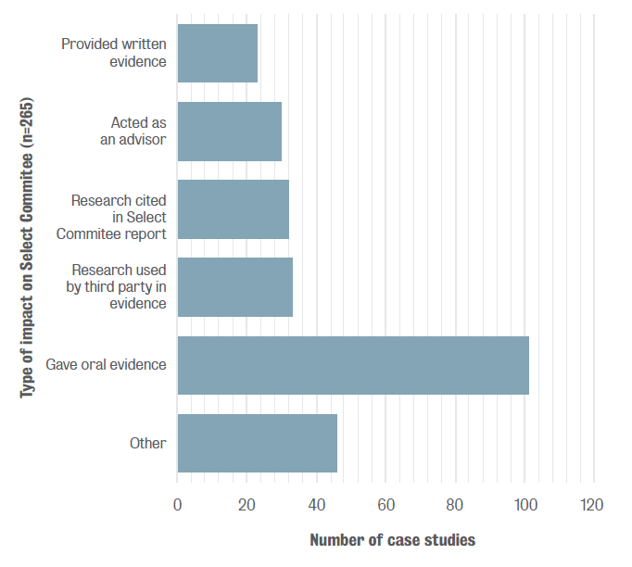
Impact on public policy and parliamentary debate
King’s College London and Digital Science, 2015

Slide 64
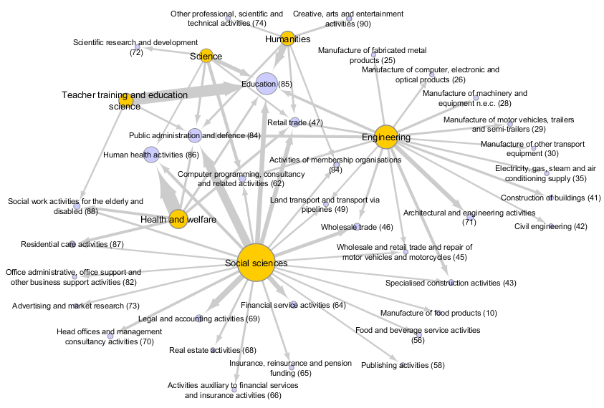
Human capital:
Social scientists are critical for service sectors, Engineers for manufacturing
Source: EU-LFS, 2013.

Slide 65
Science, Technology and Innovation Policies
– Assessment framework
Science, technology and innovation Dimension
Sub-dimension 1 Governance of STI policies | Sub-dimension 2 Research base and conditions for research excellence | Sub-dimension 3 Business investments in research and innovation and in the creation of start-ups | Sub-dimension 4 Research-industry collaboration and technology transfer
Qualitative indicators
Strategic approach to innovation Interministerial co-ordination of innovation policy Implementation of innovation policy International cooperation for R&D and technology acquisition | Governance of public research institutions (including higher education institutions) Framework for performance-based funding of public research institutions and universities | Financial support for RDI: competitive grants for research and innovation in businesses Design of fiscal support for RDI: R&D tax credits, VAT exemptions Innovation promotion Institutional support for innovation: incubators and accelerators Institutional support for innovation: technology extension services Institutional support for innovation: clusters with institutional support Public procurement for innovation | Innovation voucher schemes Competitive co-operative grants Institutional support for R&D co-operation and knowledge transfers: Technology institutes, competence centres, science and technology parks Mobility scheme between academia and industry Researcher evaluation for business-academia co-operation Intellectual Property Rights for research-industry co-operation
OECD Instruments and Tools OECD Reviews of Innovation Policies The Innovation Imperative The Knowledge Triangle synthesis report Frascati Manual Oslo Manual

Slide 66
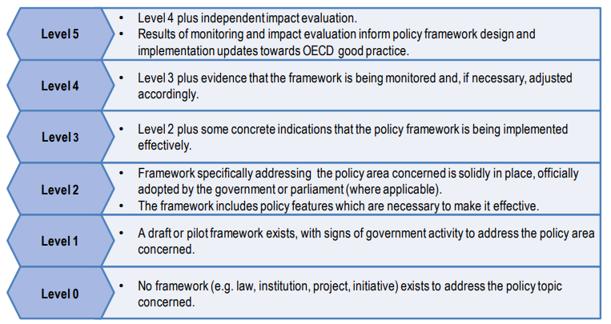
Scoring of initiatives enables effective policy benchmarking tool
Generic scores
(levels elaborated for each initiative type)

Slide 67
Illustration of detailed description for scoring the strategic approach to innovation
QL1. Strategic approach to innovation: level descriptions
0 | 1 | 2 | 3 | 4 | 5
A comprehensive innovation strategy covering the full scope of innovation from scientific research to business innovation does not exist or is obsolete. | A comprehensive innovation strategy is under development – government activity in framework drafting, conducting stakeholder consultations and/or being prepared for the adoption process. | A comprehensive innovation strategy is in place. The policy framework has 1) clear and measurable objectives, and 2) defined actions and measures with timelines and budgets to meet objectives. The policy framework/strategy/action plan/measures include: A clear structure for the overall policy governance, and in particular an efficient mechanism for interministerial co-ordination Policies and measures to enhance the research base Policies and measures to encourage business investment in innovation Policies and measures to enhance linkages between academia and business Roles and responsibilities of the different government bodies are defined, in particular the role of the Ministry of (Education and) Science and the Ministry of Economy. Stakeholder consultations have been conducted, with both academia and the private sector. Key data related to innovation (such as GERD, BERD) have been collected by a government body. | Evidence of active implementation of the innovation strategy, as measured by programme inputs and outputs of the approved innovation policy framework (at least 25% of planned activities are executed according to the timeline). There is an established implementation body (innovation agency or autonomous department of a Ministry) in charge of implementing innovation policies, with adequate human and financial resources. Public participation informs policy design and implementation. Indicators relative to innovation outcomes are collected on a regular basis | Advanced implementation of the innovation strategy through adequate policy and legal frameworks (at least 50% of planned activities are executed according to the timeline). The established implementation body has adequate human and financial resources as well as an efficient governance structure which enables it to fulfil its mandate. Planned monitoring activities assess programme inputs (budget and assets) and outputs (beneficiaries supported). Innovation information systems and databases are regularly updated and publicly available. | In addition to regular monitoring activities, impact assessments of innovation policy, legal and institutional outcomes are conducted. Horizontal policy co-ordination is in place, ensuring synergies and minimising overlaps. Clear accountability mechanisms for government bodies are in place. Administrative activities and available funding are fully aligned. Frameworks maintain policy coherence while reflecting the heterogeneous concerns of local stakeholders. Programmes are periodically assessed by external evaluators. Results of monitoring and evaluation analysis inform policy framework design and implementation updates towards OECD good practice.

Slide 68
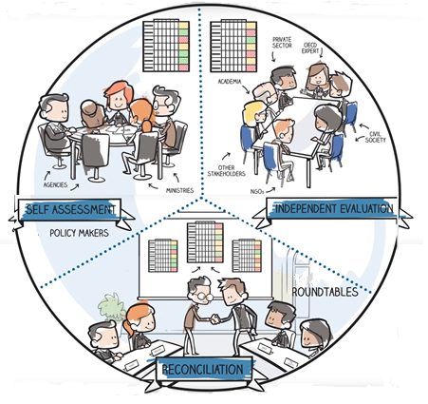
An interactive, inclusive and iterative process allows for learning by all stakeholders in the process

Slide 69
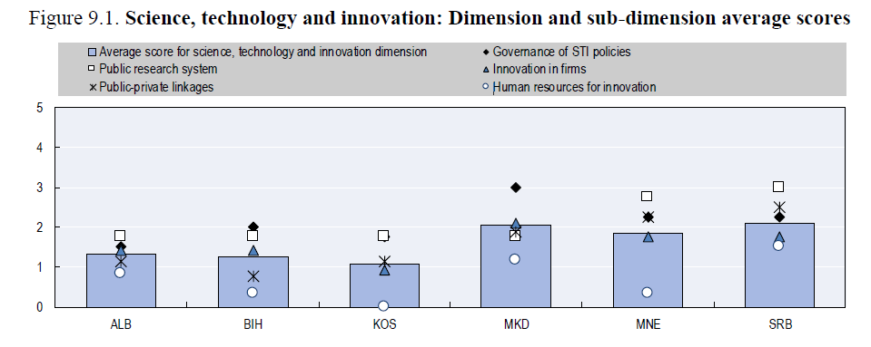
Results

Slide 70
Thank you!
Alan.Paic@oecd.org

Slide 71
Impact of Science
23-25 June, 2021
Harsha Dayal
Director of Research Department of Planning, Monitoring, and Evaluation, South Africa
#IOS21

Slide 72
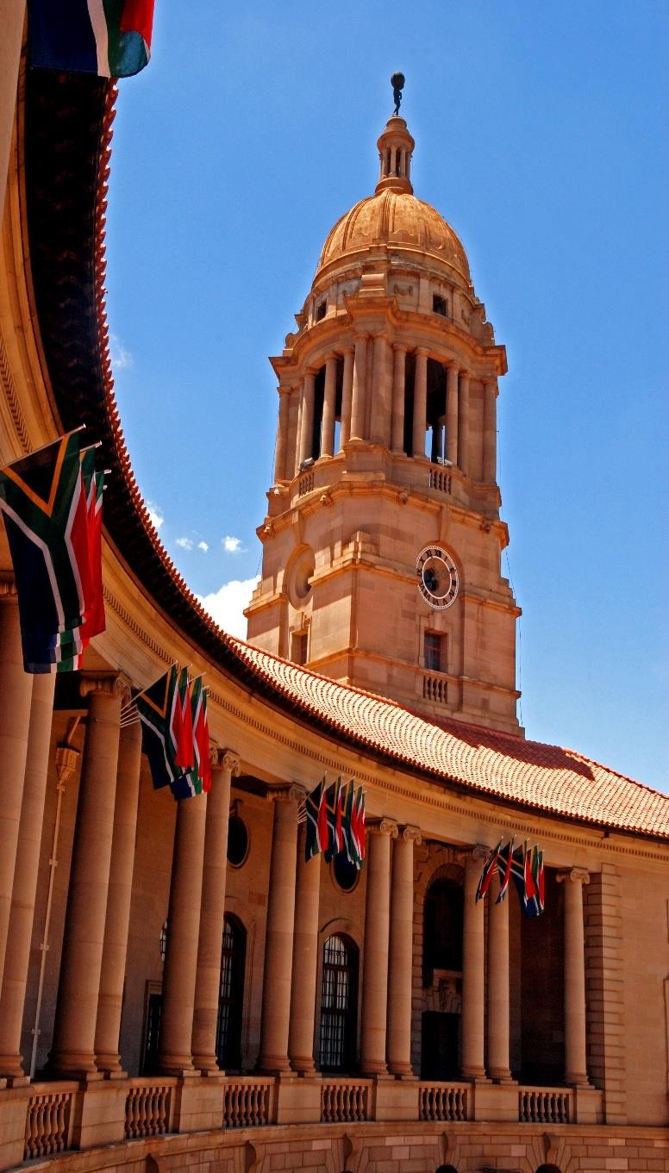



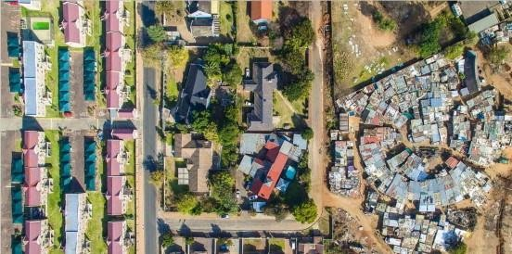
SOCIO-ECONOMIC IMPACT ASSESSMENT SYSTEM – SOUTH AFRICA
Assessment beyond bibliometrics
IMPACT OF SCIENCE CONFERENCE
Ms Harsha Dayal
Department of Planning Monitoring and Evaluation South Africa
24 June 2021

Slide 73
SEIAS – Socio Economic Impact Assessment System
SEIAS is the current practice of implementing ‘Regulatory Impact
Assessment’ in South Africa (2015)
Initial Impact
Assessment
Problem/ToC Options
Ex-ante policy analysis tool aimed at strengthening policy and law making
Decision support - it facilitates a systematic thinking process
Final Impact
Assessment
Policy/legislative alignment

Slide 74
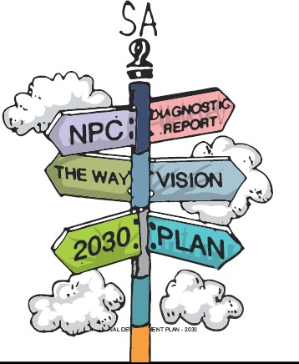


Contextualizing impact
NDP
Medium Term Strategic Framework
Sectoral plans; Delivery Agreements, Departmental & Municipal plans
MTSF is a 5-year plan to set the country on a positive trajectory to achieving the long-term vision
MTSF
2029
MTSF 2024
MTSF 2019

Slide 75

SEIAS is eviden | ce-informed
6 step policy process | Evidence need
1. The decision to develop (or amend) policies, regulations or legislations in order to address an identified social or economic problem | Contextual analysis ; Diagnostic evidence; Monitoring evidence (incl. administrative data e.g. crime and health statistics); Quantitative evidence (e.g. Surveys, Statistical Publications by Stats SA); Qualitative research (e.g. interviews, focus groups); Evaluation evidence; Stakeholder positions on the policy
2. An initial assessment involving: Problem identification and root cause analysis Identification of options for addressing the problem Rough evaluation of the costs and benefits of each option for different social/economic groups | Forecasting; Diagnostic research evidence; Diagnostic evaluation; program theory; Program Planning; Cost benefit / economic analysis; Standard costing model; Outcome mapping on different target groups
3. Agreement on the basic option and finalization of the draft policy initiatives, regulations or legislation in a process that includes consultations and a continual review of the impact assessment as the proposals evolve | Resource planning; Stakeholder consultations; Monitoring and evaluation evidence; International case studies; Diagnostic research evidence
4

Slide 76
SEIAS is evidenc | e-informed
6 step policy process | Evidence need
4. Development of final impact assessment that provides a detailed evaluation of the likely effects of the legislation in terms of implementation and compliance costs as well as the anticipated outcomes | Monitoring evidence (incl. administrative data); Trend analysis; Cost benefit analysis; Impact evaluations; Intra/inter-departmental and agencies inputs
5. Publication of the draft policy initiatives, regulation or legislation for public comment and consultation with stakeholders | Stakeholder consultations; Citizens views
6. Revision of the draft and final assessment based on comments from public, stakeholders – for approval | Political and stakeholder positions

Slide 77

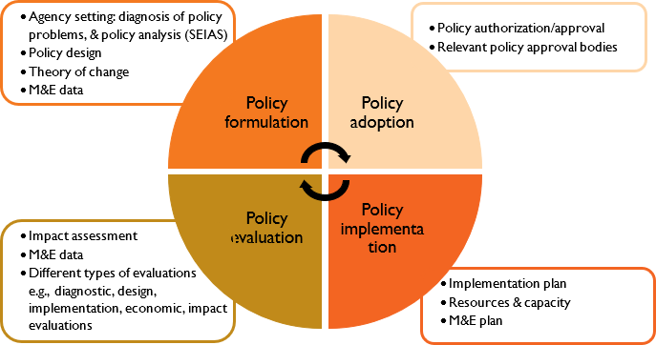








System of assessing impact
National System of Innovation & Wider research system
Monitoring system
Evaluation system Citizens feedback
7 National priorities
Political system
Capable, Ethical and Developmental State
Economic transformation and job creation
Education, skills and health
Consolidating the social wage through reliable and quality basic services
Spatial integration, human settlements and local government
Social cohesion and safer communities
A better Africa and world
Government system

Slide 78
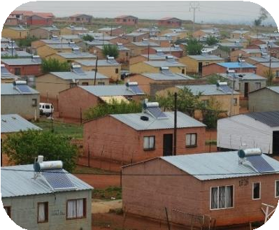


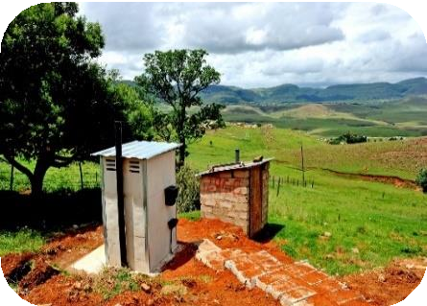




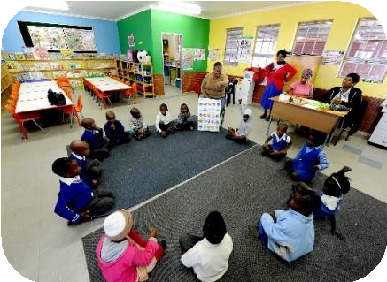
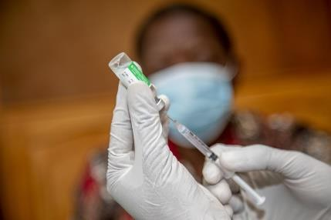
Focus on societal impact
COLLECTIVE VISION
of desired change from current status quo
ALIGNMENT
7 National developmental priorities
POLICY COHERENCE
trade-offs and spill-overs interrogated
COSTS
to government and to beneficiaries
CONSULTATIONS
of affected groups as well as across agencies inside and outside of Government

Slide 79
Implications arising out of SA case
IF
SEIAS is conceptualized and implemented on the principle of social
justice, impacting on the broader public
WHEREIN
“… a deeply unequal society like South Africa, any policy intervention
will have unequal impacts!”
THEN
following implications must be taken into consideration is assessing impact:
Using appropriate evidence where costs and benefits are measured for different social groups across society for effective comparisons
A clear understanding of “research impact” vs “societal impact”
Capacity within the public sector to generate critical (and missing) evidence on what does not work (monitoring and evaluating public policy and
interventions across ‘whole of government’)

Slide 80


Slide 81
Impact of Science
23-25 June, 2021
Thank you
#IOS21

